Slide 1
Chapter 1: Introduction to Networks
CCNA Routing and Switching
Introduction to Networks v6.0
Notes:
Cisco Networking Academy Program
Introduction to Networks v6.0
Chapter 1: Introduction to Networks

Slide 2
Chapter 1 - Sections & Objectives
1.1 Globally Connected
  Explain how multiple networks are used in every day life.
    Explain how networks affect the way we interact, learn, work and play.
    Explain how host devices can be used as clients, servers, or both.
1.2 LANs, WANs, and the Internet
  Explain how topologies and devices are connected in a small to medium-sized business network.
    Explain the use of network devices..
    Compare the devices and topologies of a LAN to the devices and topologies of a WAN.
    Describe the basic structure of the Internet.
    Explain how LANs and WANs interconnect to the Internet.
1.3 The Network as a Platform
  Explain the basic characteristics of a network that supports communication in a small to medium-sized business.
    Explain the concept of a converged network.
    Describe the four basic requirements of a reliable network.
Notes:
2
Cisco Networking Academy Program
Introduction to Networks v6.0
Chapter 1: Introduction to Networks

Slide 3
Chapter 1 - Sections & Objectives (Cont.)
1.4 The Changing Network Environment
  Explain trends in networking that will affect the use of networks in small to medium-sized businesses.
    Explain how trends such as BYOD, online collaboration, video, and cloud computing are changing the way we interact.
    Explain how networking technologies are changing the home environment.
    Identify some basic security threats and solutions for both small and large networks.
    Explain why it is important to understand the switching and routing infrastructure of a network.
Notes:
3
Cisco Networking Academy Program
Introduction to Networks v6.0
Chapter 1: Introduction to Networks

Slide 4
1.1 Globally Connected
Notes:
1 – Explore the Network
1.1 – Globally Connected

Slide 5


Networking Today
Networks in Our Daily Lives
Welcome to a world where we are more powerful together, than we ever could be apart.
Welcome to the human network.
Notes:
1.1 – Globally Connected
1.1.1 – Networking Today
1.1.1.1 Networks in Our Daily Lives

Slide 6
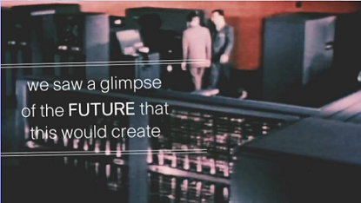
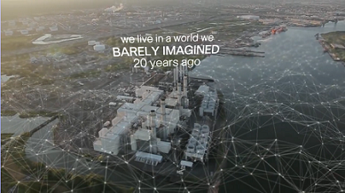
Networking Today
Technology Then and Now
We live in a world we barely imagined 20 years ago.
What wouldn’t we have without the Internet?
What will be possible in the future using the network as the platform?
Notes:
1.1 – Globally Connected
1.1.1 – Networking Today
1.1.1.2 Technology Then and Now

Slide 7

Networking Today
No Boundaries
Advancements in networking technologies are helping create a world without boundaries.
The immediate nature of communications over the Internet encourages global communities.
Cisco refers to the impact of the Internet and networks on people the “human network”.
Notes:
1.1 – Globally Connected
1.1.1 – Networking Today
1.1.1.3 No Boundaries

Slide 8


Networking Today
Networks Support the Way We Learn
Do you remember sitting in a classroom, like this?
You don't have to be in school anymore to take a class. You don't have to be in a classroom to have a teacher.
Notes:
1.1 – Globally Connected
1.1.1 – Networking Today
1.1.1.4 Networks Support the Way We Learn

Slide 9
Networking Today
Networks Support the Way We Work
The globalization of the Internet has empowered individuals to create information that can be accessed globally.
Forms of communication:
  Texting
  Social Media
  Collaboration Tools
  Blogs
  Wikis
  Podcasting
Notes:
1.1 – Globally Connected
1.1.1– Networking Today
1.1.1.6– Networks Support the Way We Work

Slide 10
Networking Today
Networks Support the Way We Work
Data networks have evolved into helping support the way we work.
Online learning opportunities decrease costly and time consuming travel.
Employee training is becoming more cost effective.
Notes:
1.1 – Globally Connected
1.1.1– Networking Today
1.1.1.6– Networks Support the Way We Work

Slide 11
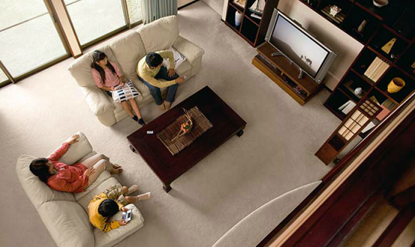
Networking Today
Networks Support the Way We Play
We listen to music, watch movies, read books, and download material for future offline access.
Networks allow online gaming in ways that were not possible 20 years ago.
Offline activities have also been enhanced by networks including global communities for a wide range of hobbies and interests.
How do you play on the Internet?
Notes:
1.1 – Globally Connected
1.1.1 – Networking Today
1.1.1.7 Networks Support the Way We Play

Slide 12
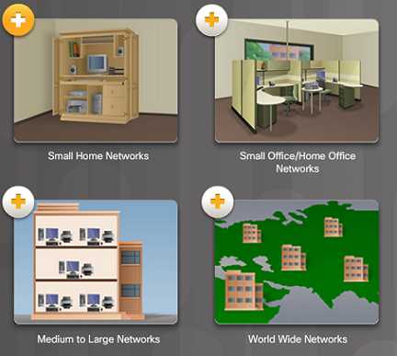
Providing Resources in a Network
Networks of Many Sizes
Small Home Networks – connect a few computers to each other and the Internet
Small Office/Home Office – enables computer within a home or remote office to connect to a corporate network
Medium to Large Networks – many locations with hundreds or thousands of interconnected computers
World Wide Networks – connects hundreds of millions of computers world-wide – such as the Internet
Notes:
1.1 – Globally Connected
1.1.2– Providing Resources in a Network
1.1.2.1 – Networks of Many Sizes

Slide 13
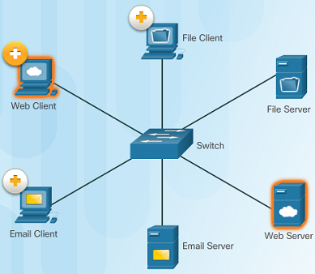
Providing Resources in a Network
Clients and Servers
Every computer connected to a network is called a host or end device.
Servers are computers that provide information to end devices on the network. For example, email servers, web servers, or file server
Clients are computers that send requests to the servers to retrieve information such as a web page from a web server or email from an email server.
Notes:
1.1 – Globally Connected
1.1.2– Providing Resources in a Network
1.1.2.2 – Clients and Servers

Slide 14
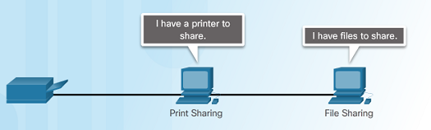
Providing Resources in a Network
Peer-to-Peer
Client and server software usually run on separate computers.
However, in small businesses or homes, it is typical for a client to also function as the server. These networks are called peer-to-peer networks.
Peer-to-peer networking advantages: easy to set up, less complex, and lower cost.
Disadvantages: no centralized administration, not as secure, not scalable, and slower performance.
Notes:
1.1 – Globally Connected
1.1.2– Providing Resources in a Network
1.1.2.3 – Peer-to-Peer

Slide 15
1.2 LANs, WANs, and the Internet
Notes:
1 – Explore the Network
1.2 – LANs, WANs, and the Internet

Slide 16
Network Components
Overview of Network Components
A network can be as simple as a single cable connecting two computers or as complex as a collection of networks that span the globe.
Network infrastructure contains three broad categories of network components:
  Devices
  Media
  Services
Notes:
1.2 – LANs, WANs, and the Internet
1.2.1 – Network Components
1.2.1.1 – Overview of Network Components

Slide 17
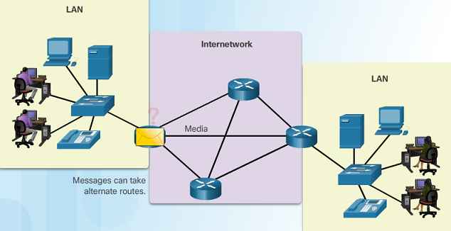
LANs, WANs, and the Internet
Network Components
End Devices
  An end device is where a message originates from or where it is received.
  Data originates with an end device, flows through the network, and arrives at an end device
Notes:
1.2 – LANs, WANs, and the Internet
1.2.1 – Network Components
1.2.1.2 – End Devices

Slide 18
Network Components
Intermediary Network Devices
An intermediary device interconnects end devices in a network. Examples include: switches, wireless access points, routers, and firewalls.
The management of data as it flows through a network is also the role of an intermediary device including:
  Regenerate and retransmit data signals.
  Maintain information about what pathways exist through the network and internetwork.
  Notify other devices of errors and communication failures.
Notes:
1.2 – LANs, WANs, and the Internet
1.2.1 – Network Components
1.2.1.3 – Intermediary Network Devices

Slide 19
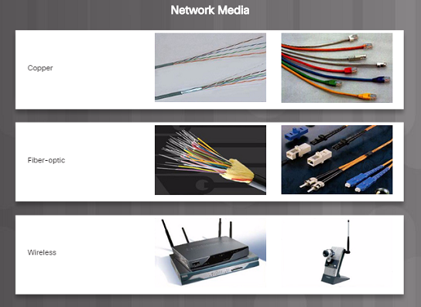
Network Components
Network Media
Communication across a network is carried through a medium which allows a message to travel from source to destination.
Networks typically use three types of media:
  Metallic wires within cables, such as copper
  Glass, such as fiber optic cables
  Wireless transmission
Notes:
1.2 – LANs, WANs, and the Internet
1.2.1 – Network Components
1.2.1.4 – Network Media

Slide 20
Network Components
Network Representations
Network diagrams, often called topology diagrams, use symbols to represent devices within the network.
In addition to the device representations on the right, it is important to remember and understand the following terms:
    Network Interface Card (NIC)
    Physical Port
    Interface
Notes:
1.2 – LANs, WANs, and the Internet
1.2.1 – Network Components
1.2.1.5 – Network Representations

Slide 21
Network Components
Topology Diagrams
Note the key differences between the two topology diagrams (physical location of devices vs. ports and network addressing schemes)
Notes:
1.2 – LANs, WANs, and the Internet
1.2.1 – Network Components
1.2.1.6 – Topology Diagrams

Slide 22
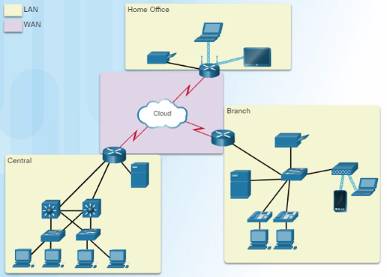
LANs and WANs
Types of Networks
Two most common types of networks:
  Local Area Network (LAN) – spans a small geographic area owned or operated by an individual or IT department.
  Wide Area Network (WAN) – spans a large geographic area typically involving a telecommunications service provider.
  Other types of networks:
    Metropolitan Area Network (MAN)
    Wireless LAN (WLAN)
    Storage Area Network (SAN)
Notes:
1.2 – LANs, WANs, and the Internet
1.2.2 – LANs and WANs
1.2.2.1 – Types of Networks

Slide 23
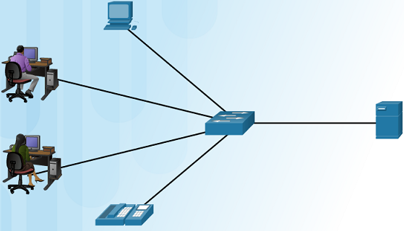
LANs and WANs
Local Area Networks
Three characteristics of LANs:
  Spans a small geographic area such as a home, school, office building, or campus.
  Usually administered by a single organization or individual.
  Provides high speed bandwidth to end and intermediary devices within the network.
Notes:
1.2 – LANs, WANs, and the Internet
1.2.2 – LANs and WANs
1.2.2.2 – Local Area Networks

Slide 24
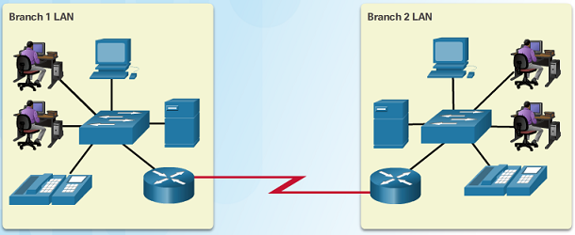
LANs and WANs
Wide Area Networks
Three characteristics of WANs:
  WANs interconnect LANs over wide geographical areas such as between cities, states, or countries.
  Usually administered by multiple service providers.
  WANs typically provide slower speed links between LANs.
Notes:
1.2 – LANs, WANs, and the Internet
1.2.2 – LANs and WANs
1.2.2.3 – Wide Area Networks

Slide 25
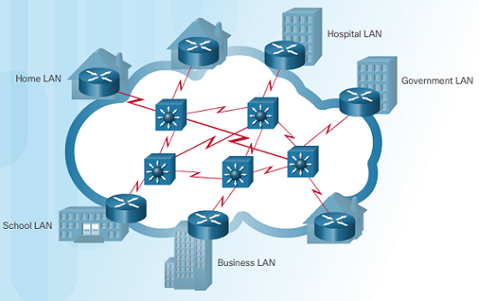
The Internet, Intranets, and Extranets
The Internet
The Internet is a worldwide collection of interconnected LANs and WANs.
LANs are connected to each other using WANs.
WANs are then connected to each other using copper wires, fiber optic cables, and wireless transmissions.
The Internet is not owned by any individual or group, however, the following groups were developed to help maintain structure:
  IETF
  ICANN
  IAB
Notes:
1.2 – LANs, WANs, and the Internet
1.2.3 – The Internet, Intranets, and Extranets
1.2.3.1 – The Internet

Slide 26
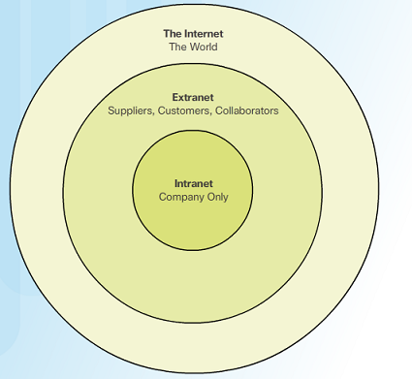
The Internet, Intranets, and Extranets
Intranets and Extranets
Unlike the Internet, an intranet is a private collection of LANs and WANs internal to an organization that is meant to be accessible only to the organizations members or others with authorization.
An organization might use an extranet to provide secure access to their network for individuals who work for a different organization that need access to their data on their network.
Notes:
1.2 – LANs, WANs, and the Internet
1.2.3 – The Internet, Intranets, and Extranets
1.2.3.2 – Intranets and Extranets

Slide 27

Internet Connections
Internet Access Technologies
There are many ways to connect users and organizations to the Internet:
  Popular services for home users and small offices include broadband cable, broadband digital subscriber line (DSL), wireless WANs, and mobile services.
  Organizations need faster connections to support IP phones, video conferencing and data center storage.
  Business-class interconnections are usually provided by service providers (SP) and may include: business DSL, leased lines, and Metro Ethernet.
Notes:
1.2 – LANs, WANs, and the Internet
1.2.4 – Internet Connections
1.2.4.1 – Internet Access Technologies

Slide 28
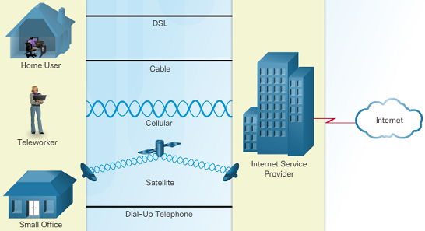
Internet Connections
Home and Small Office Internet Connections
Cable – high bandwidth, always on, Internet connection offered by cable television service providers.
DSL – high bandwidth, always on, Internet connection that runs over a telephone line.
Cellular – uses a cell phone network to connect to the Internet; only available where you can get a cellular signal.
Satellite – major benefit to rural areas without Internet Service Providers.
Dial-up telephone – an inexpensive, low bandwidth option using a modem.
Notes:
1.2 – LANs, WANs, and the Internet
1.2.4 – Internet Connections
1.2.4.2 – Home and Small Office Internet Connections

Slide 29
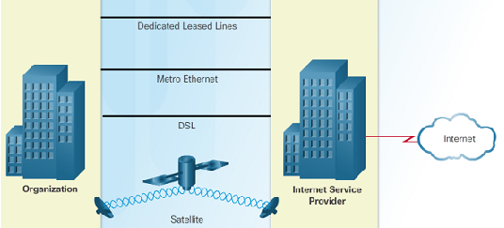
Internet Connections
Businesses Internet Connections
Corporate business connections may require higher bandwidth, dedicated connections, or managed services. Typical connection options for businesses:
  Dedicated Leased Line – reserved circuits within the service provider’s network that connect distant offices with private voice and/or data networking.
  Ethernet WAN – extends LAN access technology into the WAN.
  DSL – Business DSL is available in various formats including Symmetric Digital Subscriber Lines (SDSL).
  Satellite – can provide a connection when a wired solution is not available.
Notes:
1.2 – LANs, WANs, and the Internet
1.2.4 – Internet Connections
1.2.4.3 – Businesses Internet Connections

Slide 30
1.3 The Network as a Platform
Notes:
1 – Explore the Network
1.3 – The Network as a Platform

Slide 31
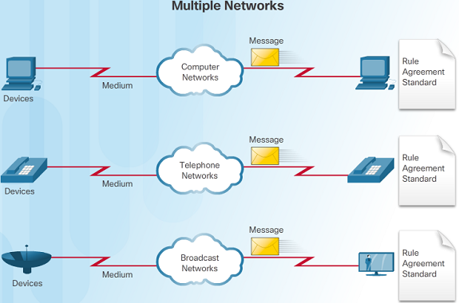
Converged Networks
Traditional Separate Networks
An example of multiple networks might be a school 30 years ago. Some classrooms were cabled for data networks. Those same classrooms were cabled for telephone networks, and also cabled separately for video.
Each of these networks used different technologies to carry the communication signals using a different set of rules and standards.
Notes:
1.3 – The Network as a Platform
1.3.1 – Converged Networks
1.3.1.1 – Traditional Separate Networks

Slide 32
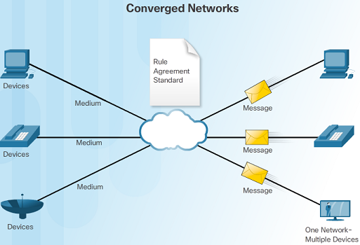
Converged Networks
The Converging Network
Converged data networks carry multiple services on one link including data, voice, and video.
Unlike dedicated networks, converged networks can deliver data, voice, and video between different types of devices over the same network infrastructure.
The network infrastructure uses the same set of rules and standards.
Notes:
1.3 – The Network as a Platform
1.3.1 – Converged Networks
1.3.1.2 – The Converging Network

Slide 33
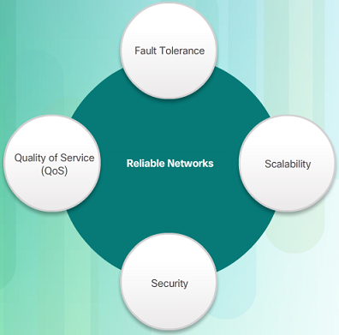
Reliable Network
Network Architecture
Network Architecture refers to the technologies that support the infrastructure that moves data across the network.
There are four basic characteristics that the underlying architectures need to address to meet user expectations:
  Fault Tolerance
  Scalability
  Quality of Service (QoS)
  Security
Notes:
1.3 – The Network as a Platform
1.3.2 – Reliable Network
1.3.2.1 – Network Architecture

Slide 34
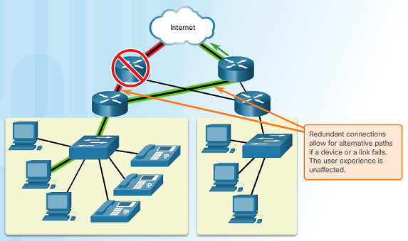
Reliable Network
Fault Tolerance
A fault tolerant network limits the impact of a failure by limiting the number of affected devices.
Multiple paths are required for fault tolerance.
Reliable networks provide redundancy by implementing a packet switched network. Packet switching splits traffic into packets that are routed over a network. Each packet could theoretically take a different path to the destination.
This is not possible with circuit-switched networks which establish dedicated circuits.
Notes:
1.3 – The Network as a Platform
1.3.2 – Reliable Network
1.3.2.2 – Fault Tolerance

Slide 35
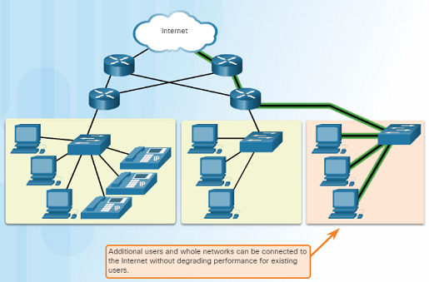
Reliable Network
Scalability
A scalable network can expand quickly and easily to support new users and applications without impacting the performance of services to existing users.
Network designers follow accepted standards and protocols in order to make the networks scalable.
Notes:
1.3 – The Network as a Platform
1.3.2 – Reliable Network
1.3.2.3 – Scalability

Slide 36
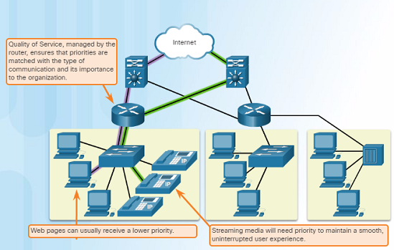
Reliable Network
Quality of Service
Voice and live video transmissions require higher expectations for those services being delivered.
Have you ever watched a live video with constant breaks and pauses? This is caused when there is a higher demand for bandwidth than available – and QoS isn’t configured.
Quality of Service (QoS) is the primary mechanism used to ensure reliable delivery of content for all users.
With a QoS policy in place, the router can more easily manage the flow of data and voice traffic.
Notes:
1.3 – The Network as a Platform
1.3.2 – Reliable Network
1.3.2.4 – Quality of Service

Slide 37
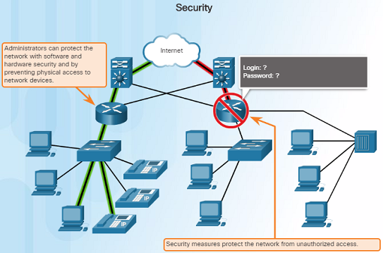
Reliable Network
Security
There are two main types of network security that must be addressed:
  Network infrastructure security
    Physical security of network devices
    Preventing unauthorized access to the management software on those devices
  Information Security
    Protection of the information or data transmitted over the network
Three goals of network security:
  Confidentiality – only intended recipients can read the data
  Integrity – assurance that the data has not be altered with during transmission
  Availability – assurance of timely and reliable access to data for authorized users
Notes:
1.3 – The Network as a Platform
1.3.2 – Reliable Network
1.3.2.5 – Security

Slide 38
1.4 The Changing Network Environment
Notes:
1 – Explore the Network
1.4 – The Changing Network Environment

Slide 39
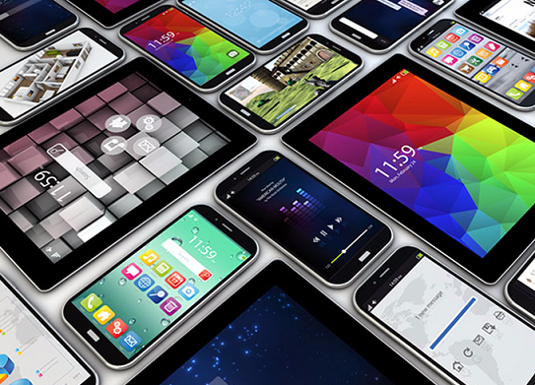
Network Trends
New Trends
The role of the network must adjust and continually transform in order to be able to keep up with new technologies and end user devices as they constantly come to the market.
Several new networking trends that effect organizations and consumers:
  Bring Your Own Device (BYOD)
  Online collaboration
  Video communications
  Cloud computing
Notes:
1.4 – The Changing Network Environment
1.4.1 – Network Trends
1.4.1.1 – New Trends

Slide 40

Network Trends
Bring Your Own Device
Bring Your Own Device (BYOD) is a major global trend that allows users to use their own devices giving them more opportunities and greater flexibility.
BYOD allows end users to have the freedom to use personal tools to access information and communicate using their:
  Laptops
  Netbooks
  Tablets
  Smartphones
  E-readers
Notes:
1.4 – The Changing Network Environment
1.4.1 – Network Trends
1.4.1.2 – Bring Your Own Device

Slide 41
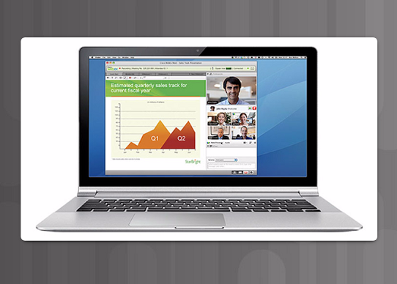
Network Trends
Online Collaboration
Individuals want to collaborate and work with others over the network on joint projects.
Collaboration tools including Cisco WebEx (shown in the figure) gives users a way to instantly connect, interact and achieve their objectives.
Collaboration is a very high priority for businesses and in education.
Notes:
1.4 – The Changing Network Environment
1.4.1 – Network Trends
1.4.1.3 – Online Collaboration

Slide 42
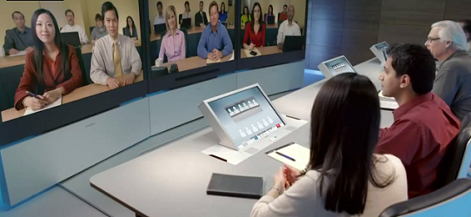
Network Trends
Video Communication
Cisco TelePresence powers the new way of working where everyone, everywhere, can be more productive through face to face collaboration.
Around the world each day, we transform organizations by transforming our customer experiences.
Notes:
1.4 – The Changing Network Environment
1.4.1 – Network Trends
1.4.1.4 – Video Communication

Slide 43
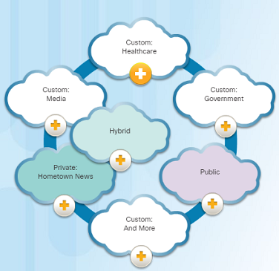
Network Trends
Cloud Computing
Cloud computing is a global trend that allows us to store personal files or backup our data on servers over the Internet.
Applications such as word processing and photo editing can also be accessed using the Cloud.
Cloud computing also allows businesses to extend their capabilities on demand and delivered automatically to any device anywhere in the world.
Cloud computing is made possible by data centers. Smaller companies that can’t afford their own data centers, lease server and storage services from larger data center organizations in the Cloud.
Notes:
1.4 – The Changing Network Environment
1.4.1 – Network Trends
1.4.1.5 – Cloud Computing

Slide 44
Network Trends
Cloud Computing (Cont.)
Four types of Clouds:
  Public Clouds
    Services and applications are made available to the general public through a pay-per-use model or for free.
  Private Clouds
    Applications and services are intended for a specific organization or entity such as the government.
  Hybrid Clouds
    Made up of two or more Cloud types – for example, part custom and part public. Each part remains a distinctive object but both are connected using the same architecture.
  Custom Clouds
Notes:
1.4 – The Changing Network Environment
1.4.1 – Network Trends
1.4.1.5 – Cloud Computing

Slide 45
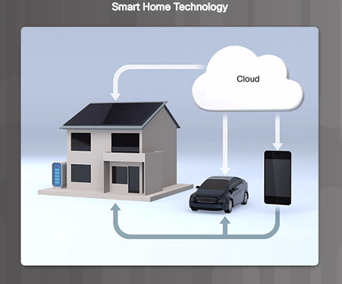
Network Trends
Technology Trends in the Home
  Smart home technology is a growing trend that allows technology to be integrated into every-day appliances which allows them to interconnect with other devices.
  Ovens might know what time to cook a meal for you by communicating with your calendar on what time you are scheduled to be home.
Notes:
1.4 – The Changing Network Environment
1.4.1 – Network Trends
1.4.2.1 – Technology Trends in the Home

Slide 46
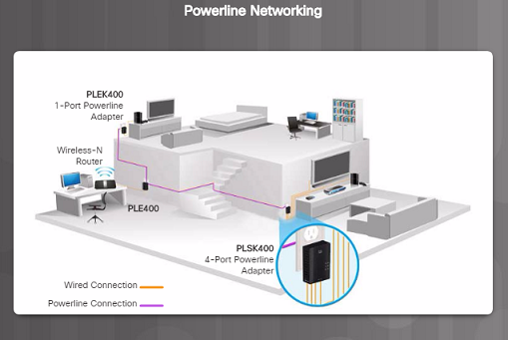
Network Trends
Powerline Networking
  Powerline networking can allow devices to connect to a LAN where data network cables or wireless communications are not a viable option.
  Using a standard powerline adapter, devices can connect to the LAN wherever there is an electrical outlet by sending data on certain frequencies.
Notes:
1.4 – The Changing Network Environment
1.4.1 – Network Trends
1.4.2.2 – Powerline Networking

Slide 47
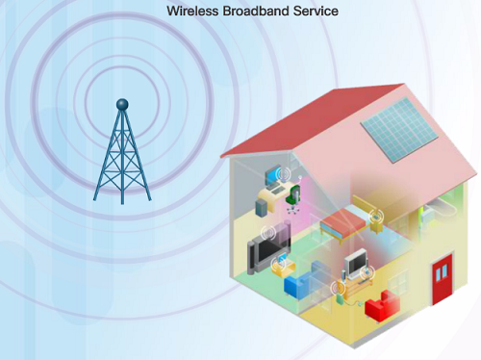
Network Trends
Wireless Broadband
  In addition to DSL and cable, wireless is another option used to connect homes and small businesses to the Internet.
  More commonly found in rural environments, a Wireless Internet Service Provider (WISP) is an ISP that connects subscribers to designated access points or hotspots.
  Wireless broadband is another solution for the home and small businesses.
    Uses the same cellular technology used by a smart phone.
    An antenna is installed outside the house providing wireless or wired connectivity for devices in the home.
Notes:
1.4 – The Changing Network Environment
1.4.1 – Network Trends
1.4.2.3 – Wireless Broadband

Slide 48
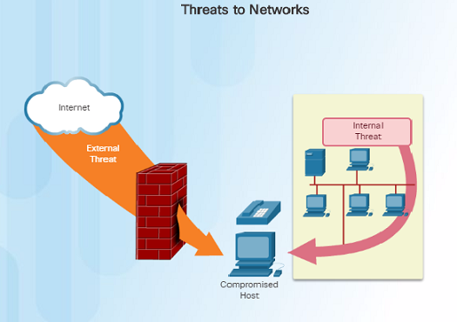
Network Security
Security Threats
  Network security is an integral part of networking regardless of the size of the network.
  The network security that is implemented must take into account the environment while securing the data, but still allowing for quality of service that is expected of the network.
  Securing a network involves many protocols, technologies, devices, tools, and techniques in order to secure data and mitigate threats.
  Threat vectors might be external or internal.
Notes:
1.4 – The Changing Network Environment
1.4.1 – Network Security
1.4.3.1 – Security Threats

Slide 49
Network Security
Security Threats (Cont.)
  External threats:
    Viruses, worms, and Trojan horses
    Spyware and adware
    Zero-day attacks, also called zero-hour attacks
    Hacker attacks
    Denial of Service attacks
    Data interception and theft
    Identify Theft
  Internal threats:
    Whether intentional or not, many studies show that the internal users of the network cause the most security breaches.
    With BYOD strategies, corporate data is more vulnerable.
Notes:
1.4 – The Changing Network Environment
1.4.1 – Network Security
1.4.3.1 – Security Threats

Slide 50
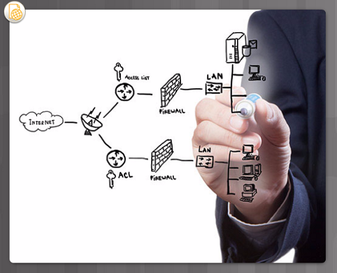
Network Security
Security Solutions
  Security must be implemented in multiple layers using more than one security solution.
  Network security components for home or small office network:
    Antivirus and antispyware software should be installed on end devices.
    Firewall filtering used to block unauthorized access to the network.
Notes:
1.4 – The Changing Network Environment
1.4.1 – Network Security
1.4.3.2 – Security Solutions

Slide 51
Network Security
Security Solutions (Cont.)
  Larger networks have additional security requirements:
    Dedicated firewall system to provide more advanced firewall capabilities.
    Access control lists (ACL) – used to further filter access and traffic forwarding.
    Intrusion prevention systems (IPS) – used to identify fast-spreading threats such as zero-day attacks.
    Virtual private networks (VPN) – used to provide secure access for remote workers.
Notes:
1.4 – The Changing Network Environment
1.4.1 – Network Security
1.4.3.2 – Security Solutions

Slide 52
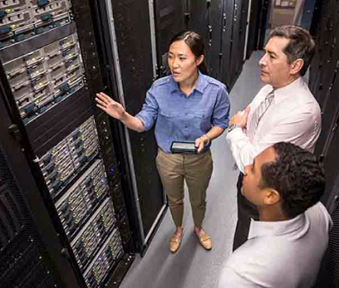
Network Architecture
Cisco Network Architecture
  In order for networks to function while efficiently supporting connections of people, devices, and information in a media rich converged environment, the network must be built upon a standard network architecture.
  Network architecture refers to the devices, connections, and products that are integrated to support the necessary technologies and applications.
  The foundation of all network architectures including the Internet are routers and switches.
Notes:
1.4 – The Changing Network Environment
1.4.4 – Network Architecture
1.4.4.1 – Cisco Network Architecture

Slide 53
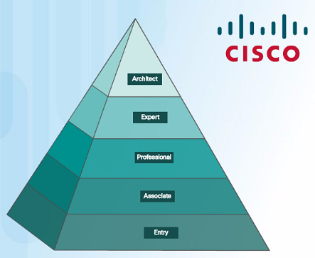
Network Architecture
CCENT and CCNA Certification
  Cisco Certified Network Associate (CCNA)
    Routing and Switching Certification
      Requires you to pass two exams:
        First exam: Cisco Certified Entry Network Technician (CCENT)
        Second exam focuses on IPv4 and IPv6 routing and WAN technologies as well as LAN switching and infrastructure services/maintenance
Notes:
1.4 – The Changing Network Environment
1.4.4 – Network Architecture
1.4.4.2 – CCENT and CCNA Certification

Slide 54
1.5 Chapter Summary
Notes:
X – Chapter Title
X.X – Summary

Slide 55
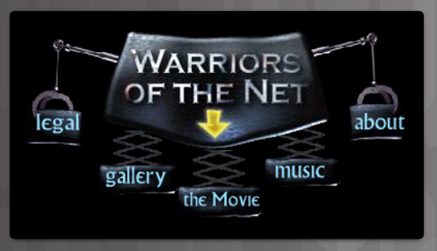
Conclusion
Warriors of the Net
The animated video below will help you visualize networking concepts.
http://www.warriorsofthe.net/
Notes:
1.5 – Summary
1.5.1 – Conclusion
1.5.1.2 – Warriors of the Net

Slide 56
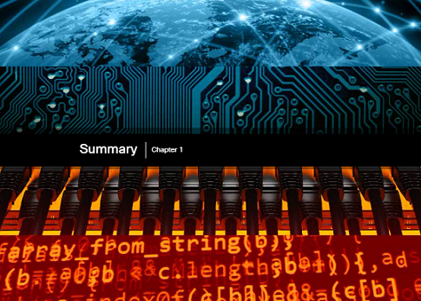
Conclusion
Exploring the Network
Networks and the Internet have dramatic impact on our lives.
A network can consist of two devices, or can be as large as the Internet, consisting of millions of devices.
The network infrastructure is the platform that supports the network.
Networks must be:
  Fault tolerant
  Scalable
  Support Quality of Service
  Secure
Notes:
1.5 – Summary
1.5.1 – Conclusion
1.5.1.3 – Exploring the Network

Slide 57
Conclusion
Chapter 1: Introduction to Networks
Explain how multiple networks are used in every day life.
Explain how topologies and devices are connected in a small to medium-sized business network.
Explain the basic characteristics of a network that support communication in a small to medium-sized business.
Explain trends in networking that will affect the use of networks in small to medium-sized businesses.
Notes:
1.5 – Summary
1.5.1 – Conclusion

Slide 58
Chapter 1
New Terms and Commands
Peer-to-Peer File Sharing Small Office/Home Office or SOHO Medium to large network Server Client Peer-to-Peer network End device Intermediary device Medium Network Interface Card (NIC) Physical Port Interface Physical topology diagram | Logical topology diagram Local Area Network (LAN) Wide Area Network (WAN) Internet Intranet Extranet Internet Service Provider (ISP) Converged networks Network architecture Fault tolerant network Packet-switched network Circuit-switched network Scalable network Quality of Service (Qos) | Network bandwidth Bring Your Own Device (BYOD) Collaboration Cloud computing Private clouds Hybrid clouds Public clouds Custom clouds Data center Smart home technology Powerline networking Wireless Internet Service Provider (WISP) Network architecture
Notes:
New Terms and Commands

