Slide 1
Chapter 9: NAT for IPv4
CCNA Routing and Switching
Routing and Switching Essentials v6.0
Notes:
Cisco Networking Academy Program
Routing and Switching Essentials v6.0
Chapter 9: NAT for IPv4

Slide 2
Chapter 9 - Sections & Objectives
9.1 NAT Operation
Explain how NAT provides IPv4 address scalability in a small to medium-sized business network
Explain the purpose and function of NAT.
Explain the operation of different types of NAT.
Describe the advantages and disadvantages of NAT.
9.2 Configure NAT
Configure NAT services on the edge router to provide IPv4 address scalability in a small to medium-sized business network.
Configure static NAT using the CLI.
Configure dynamic NAT using the CLI.
Notes:
2
Cisco Networking Academy Program
Routing and Switching Essentials v6.0
Chapter 9: NAT for IPv4

Slide 3
Chapter 9 - Sections & Objectives (Cont.)
9.2 Configure NAT (Cont.)
Configure PAT using the CLI.
Configure port forwarding using the CLI.
9.3 Troubleshoot NAT
Troubleshoot NAT issues in a small to medium-sized business network.
Troubleshoot NAT
Notes:
3
Cisco Networking Academy Program
Routing and Switching Essentials v6.0
Chapter 9: NAT for IPv4

Slide 4
9.1 NAT Operation
Notes:
9 – NAT for IPv4
9.1 – NAT Operation

Slide 5
NAT Characteristics IPv4 Private Address Space
Did you ever notice how all your labs were based on these addresses?
Private IP addresses are used within an organization and home networks.
These are the IP addresses you will see assigned to company devices.
Notes:
9.1 – NAT Operation
9.1.1 – NAT Characteristics
9.1.1.1 – IPv4 Private Address Space

Slide 6
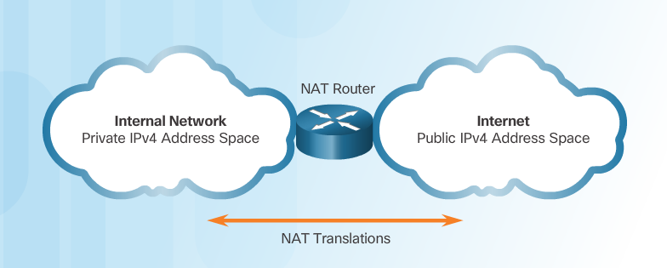
NAT Characteristics IPv4 Private Address Space (Cont.)
Private IP addresses cannot be routed over the Internet.
NAT is used to translate private IP addresses to public addresses that can be routed over the Internet.
One public IPv4 address can be used for thousands of devices that have private IP addresses.
Notes:
9.1 – NAT Operation
9.1.1 – NAT Characteristics
9.1.1.1 – IPv4 Private Address Space

Slide 7
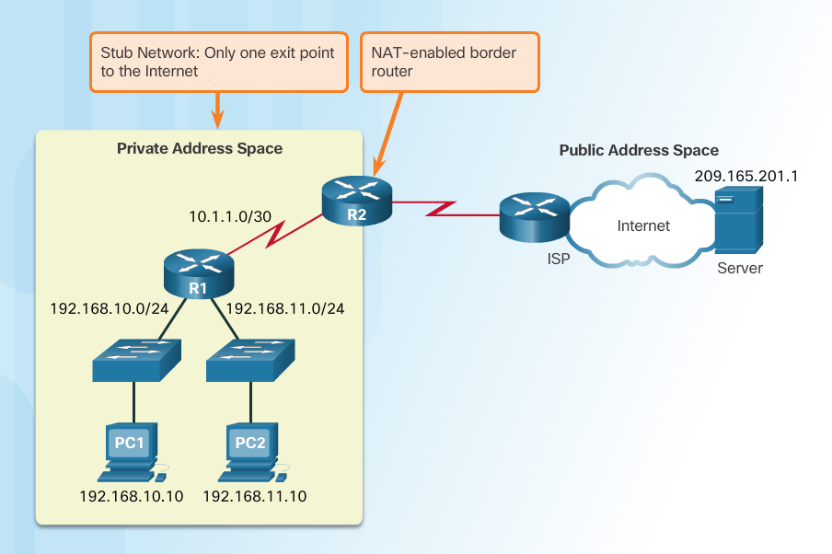
NAT Characteristics What is NAT?
Important Concept—NAT is enabled on one device (normally the border or edge router)
Private IP addresses cannot be routed over the Internet.
NAT is used to translate private IP addresses used inside a company to public addresses that can be routed over the Internet.
NAT hides internal IPv4 addresses from outside networks.
Companies use the same private IPv4 addresses so outside devices cannot tell one company’s 10.x.x.x network from another company’s 10.x.x.x network.
A NAT-enabled router can be configured with a public IPv4 address.
A NAT-enabled router can be configured with multiple public IPv4 addresses to be used in a pool or NAT pool for internal devices configured with private addresses.
Notes:
9.1 – NAT Operation
9.1.1 – NAT Characteristics
9.1.1.2 – What is NAT?

Slide 8
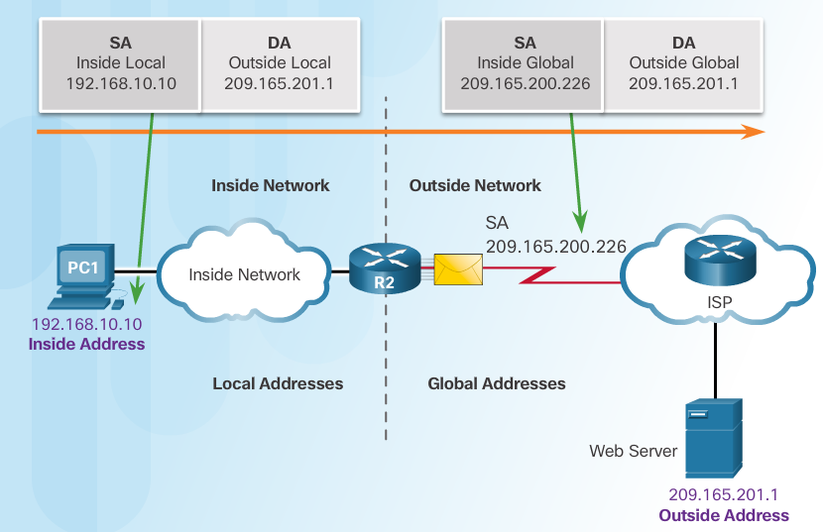
NAT Characteristics NAT Terminology
Four types of addresses: inside, outside, local, and global
Always consider the device that is having its private address translated to understand this concept.
Inside address – address of the company network device that is being translated by NAT
Outside address – IP address of the destination device
Local address – any address that appears on the inside portion of the network
Global address – any address that appears on the outside portion of the network
Notes:
9.1 – NAT Operation
9.1.1 – NAT Characteristics
9.1.1.3 –NAT Terminology

Slide 9
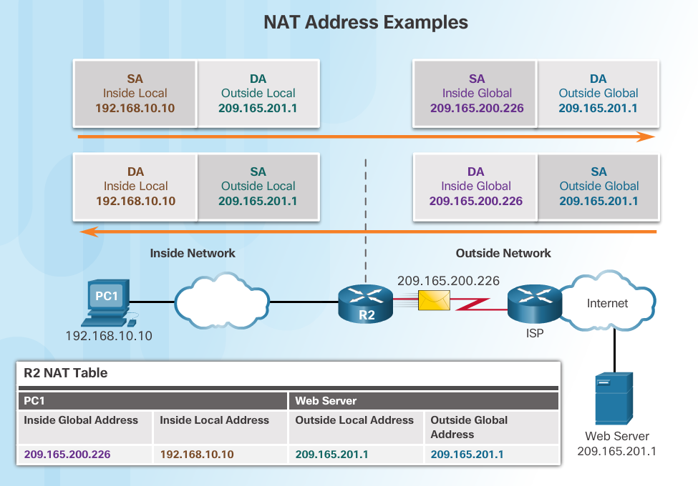
NAT Characteristics NAT Terminology (Cont.)
Notes:
9.1 – NAT Operation
9.1.1 – NAT Characteristics
9.1.1.4 –NAT Terminology (Cont.)

Slide 10
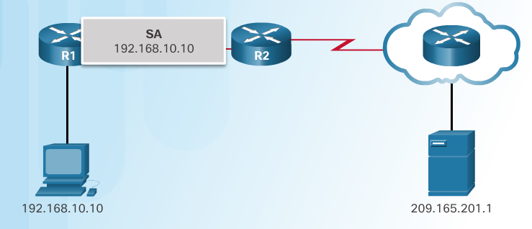
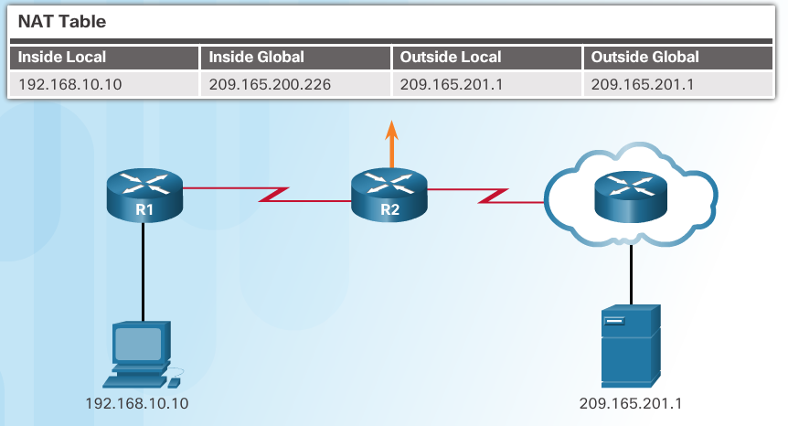
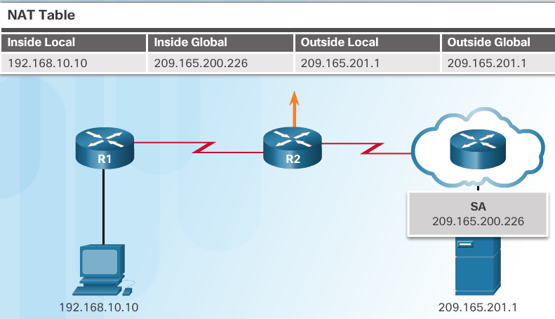
NAT Characteristics How NAT Works
1. The private (internal) IP address gets translated to a public IP address used to reach the external server.
Notes:
9.1 – NAT Operation
9.1.1 – NAT Characteristics
9.1.1.5 – How NAT Works

Slide 11
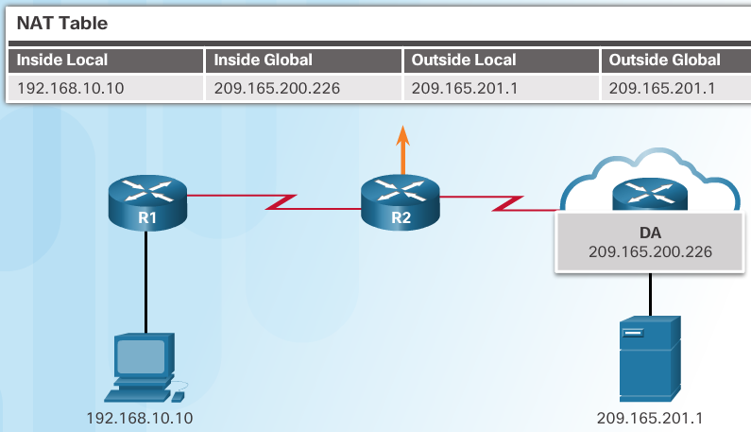
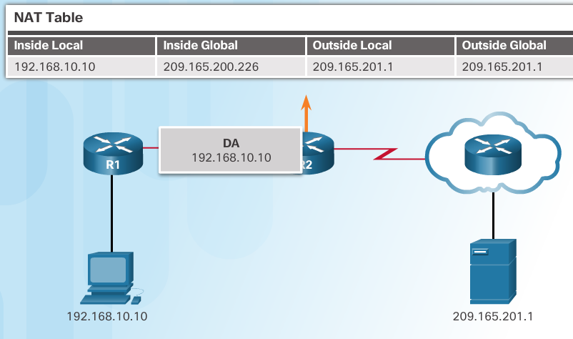
NAT Characteristics How NAT Works (Cont.)
2. The translated public address is used by the server to send the requested information to the device that actually has a private IP address assigned to it.
3. The NAT-enabled router consults the routing table to see what private address requested the data.
Notes:
9.1 – NAT Operation
9.1.1 – NAT Characteristics
9.1.1.5 – How NAT Works (Cont.)

Slide 12
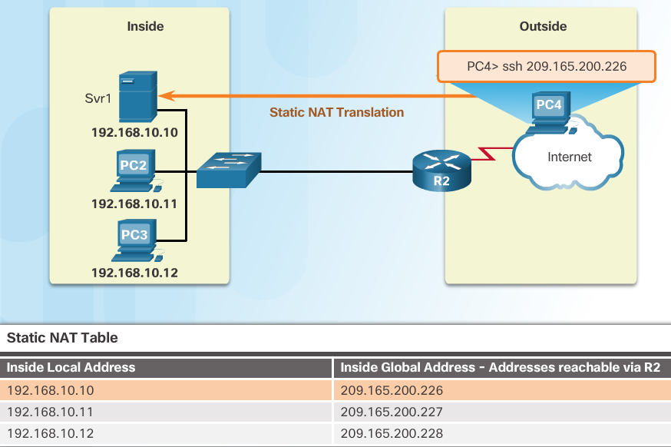
Types of NAT Static NAT
Static address translation (static NAT) assigns one public IP address to one private IP address
Commonly used for servers that need to be accessed by external devices or for devices that must be accessible by authorized personnel when offsite
One-to-one address mapping between local and global addresses
Notes:
9.1 – NAT Operation
9.1.2 – Types of NAT
9.1.2.1 – Static NAT

Slide 13
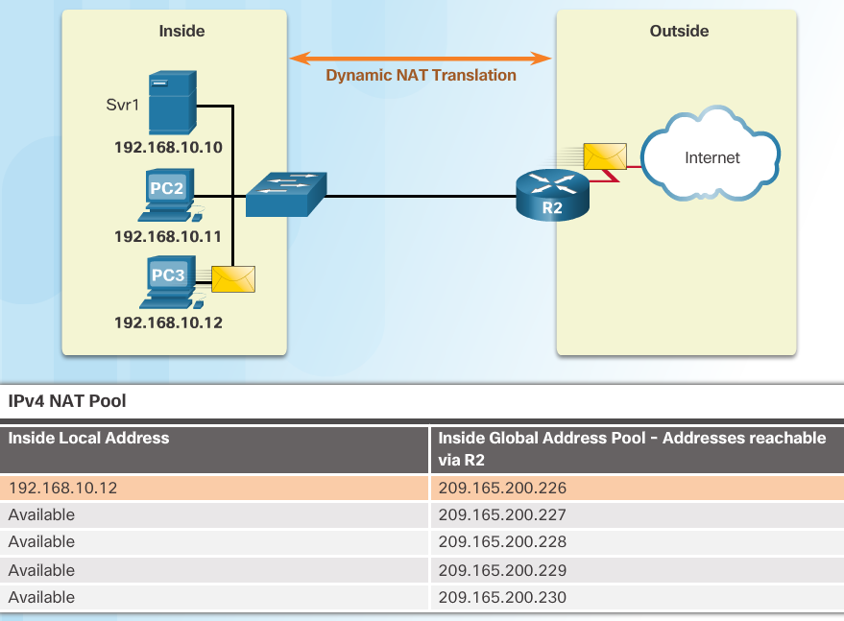
Types of NAT Dynamic NAT
Dynamic NAT assigns a public IP address from a pool of addresses to each packet that originates from a device that has a private IP address assigned when that packet is destined to a network outside the company.
Addresses are assigned on a first-come, first serve basis
The number of internal devices that can transmit outside the company is limited to the number of public IP addresses in the pool.
Notes:
9.1 – NAT Operation
9.1.2 – Types of NAT
9.1.2.2 – Dynamic NAT

Slide 14
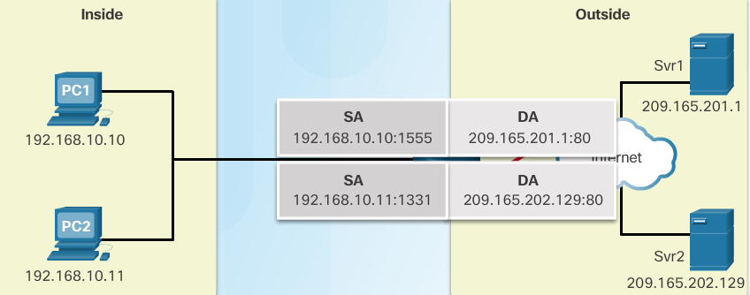
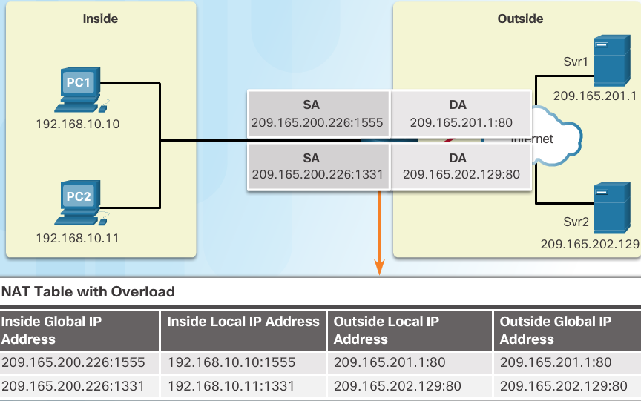
Types of NAT Port Address Translation (PAT)
PAT (otherwise known as NAT overload) can use one public IPv4 address to allow thousand of private IPv4 addresses to communicate with outside network devices.
Uses port numbers to track the session
Notes:
9.1 – NAT Operation
9.1.2 – Types of NAT
9.1.2.3 – Port Address Translation (PAT)

Slide 15
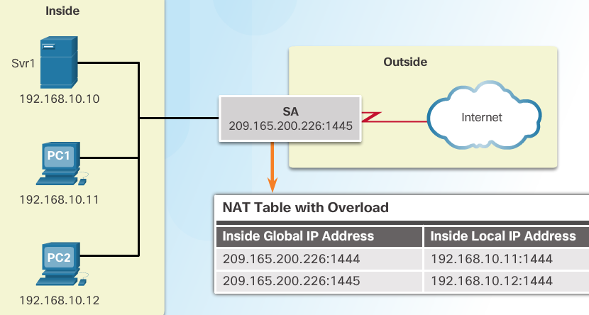
Types of NAT Next Available Port
PAT tries to preserve the original source port number.
If that port number is already use, PAT will assign the first available port number for the appropriate port group
0 - 511
512 - 1023
1024 - 65,535
When there are no more port numbers available, PAT moves to the next public IP address in the pool if there is one.
1. Notice how traffic is from two different internal devices using the same port number.
2. Notice how PAT uses the same public address, but two different port numbers.
Notes:
9.1 – NAT Operation
9.1.2 – Types of NAT
9.1.2.4 – Next Available Port

Slide 16
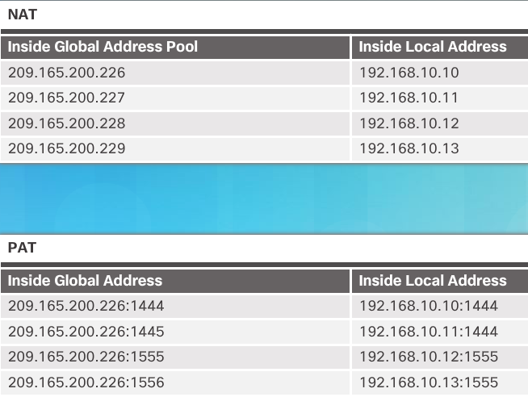
Types of NAT Comparing NAT and PAT
Static NAT translates address on a 1:1 basis
PAT uses port numbers so that one public address can be used for multiple privately addressed devices
PAT can still function with a protocol such as ICMP that does not use TCP or UDP
Notes:
9.1 – NAT Operation
9.1.2 – Types of NAT
9.1.2.5 – Comparing NAT and PAT

Slide 17
NAT Advantages Advantages of NAT
Conserves the legally registered addressing scheme
Every company can use the private IP addresses
Increases the flexibility of connections to the public network
Multiple NAT pools, backup pools, and load-balancing across NAT pools
Provides consistency for internal network addressing schemes
Do not have to readdress the network if a new ISP or public IP address is assigned
Provides network security
Hides user private IPv4 addresses
Notes:
9.1 – NAT Operation
9.1.3 – NAT Advantages
9.1.3.1 – Advantages of NAT

Slide 18
NAT Advantages Disadvantages of NAT
Performance is degraded.
The NAT-enabled border device must track and process each session destined for an external network.
End-to-end functionality is degraded.
Translation of each IPv4 address within the packet headers takes time.
End-to-end IP traceability is lost.
Some applications require end-to-end addressing and cannot be used with NAT.
Static NAT mappings can sometimes be used.
Troubleshooting can be more challenging.
Tunneling becomes more complicated.
Initiating TCP connections can be disrupted.
Notes:
9.1 – NAT Operation
9.1.3 – NAT Advantages
9.1.3.2 – Disadvantages of NAT

Slide 19
9.2 Configure NAT
Notes:
9 – NAT for IPv4
9.2 – Configure NAT

Slide 20
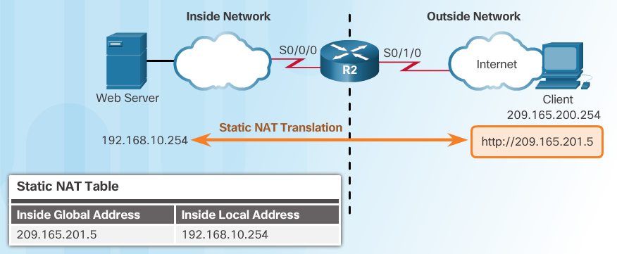
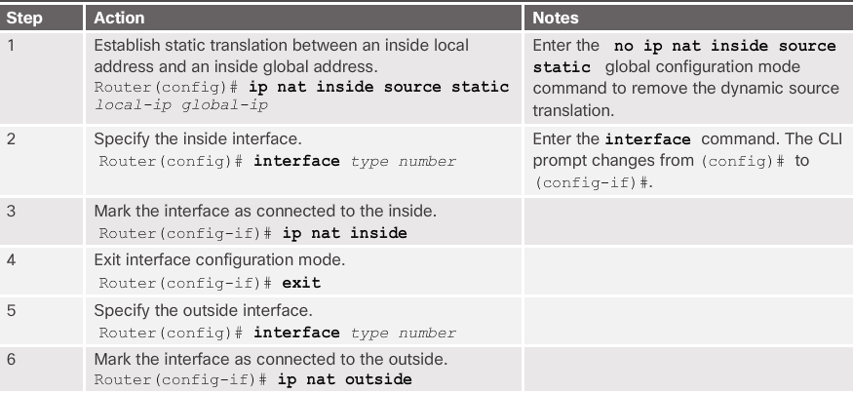
Configuring Static NAT Configure Static NAT
Notes:
9.2 – Configure NAT
9.2.1 – Configuring Static NAT
9.2.1.1 – Configure Static NAT

Slide 21
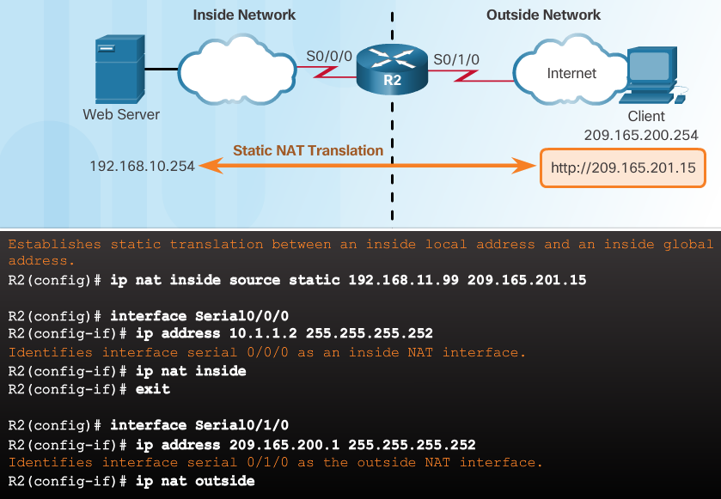
Configuring Static NAT Configure Static NAT (Cont.)
Inside interface
Outside interface
Remember that any interface on the border router that is on the inside network must be configured with the ip nat inside command. This is a common mistake for those new to NAT.
Notes:
9.2 – Configure NAT
9.2.1 – Configuring Static NAT
9.2.1.1 – Configure Static NAT

Slide 22
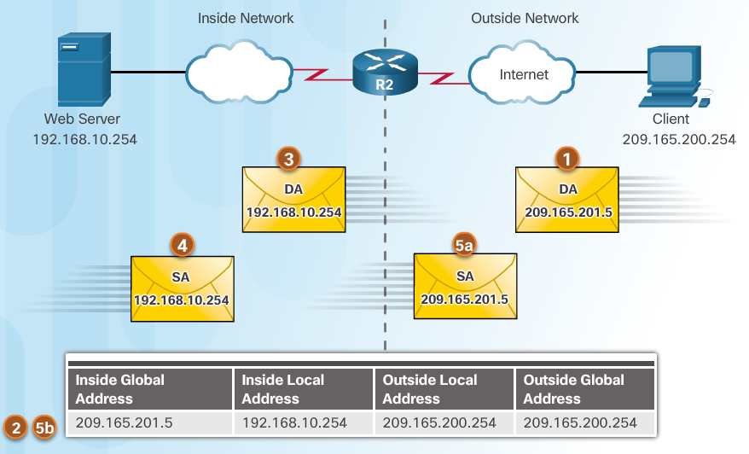
Configuring Static NAT Analyzing Static NAT
Client opens a web browser for a connection to a web server.
R2 receives the packet on the outside interface and checks the NAT table.
R2 replaces the inside global address with inside local address of 192.168.10.254 (the server’s address).
Web server responds to the client.
(a) R2 receives the packet from the server on the inside address. (b) R2 checks NAT table and translates the source address to the inside global address of 209165.201.5 and forwards the packet.
The client receives the packet.
Notes:
9.2 – Configure NAT
9.2.1 – Configuring Static NAT
9.2.1.2 – Analyzing Static NAT

Slide 23
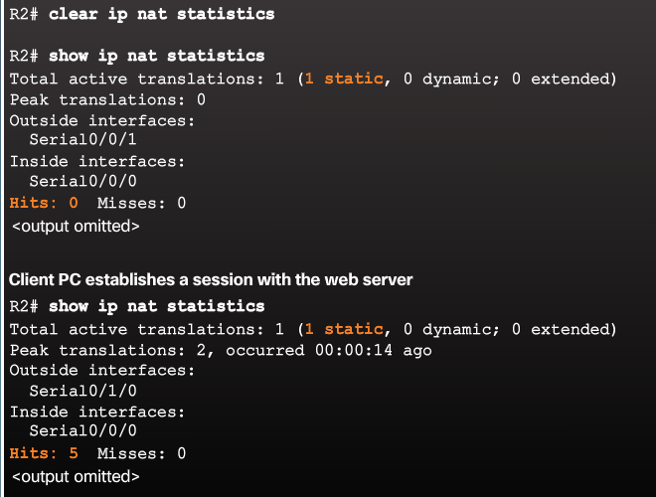
Configuring Static NAT Verifying Static NAT
A best practice is to clear statistics when verifying that NAT is working.
Important commands:
show ip nat translations
show ip nat statistics
Notes:
9.2 – Configure NAT
9.2.1 – Configuring Static NAT
9.2.1.3 – Verifying Static NAT

Slide 24
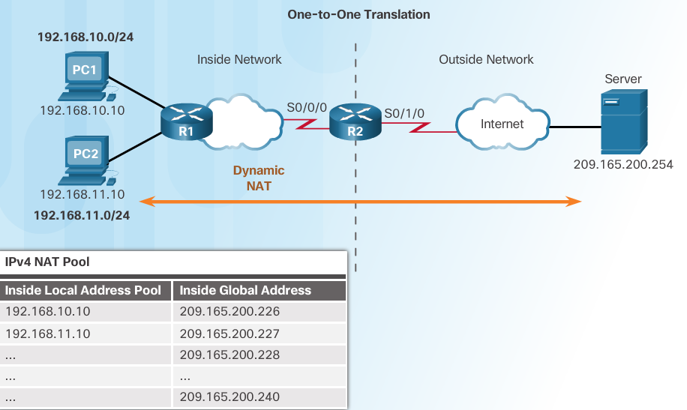
Configure Dynamic NAT Dynamic NAT Operation
Remember that dynamic NAT uses a pool of public IPv4 addresses.
Use the same concepts of inside and outside NAT interfaces as static NAT.
Notes:
9.2 – Configure NAT
9.2.2 – Configure Dynamic NAT
9.2.2.1 – Dynamic NAT Operation

Slide 25
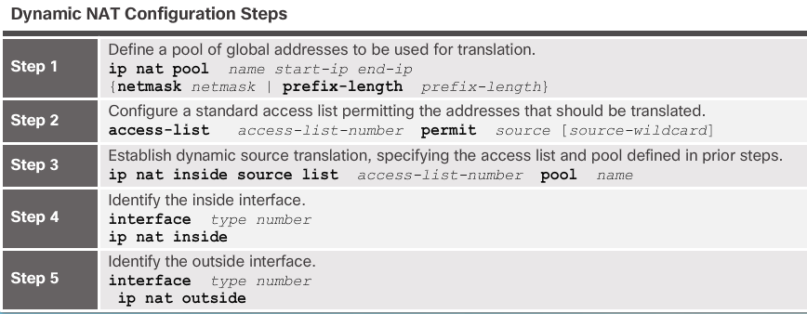
Configure Dynamic NAT Configuring Dynamic NAT
Notes:
9.2 – Configure NAT
9.2.2 – Configure Dynamic NAT
9.2.2.2 – Configuring Dynamic NAT

Slide 26
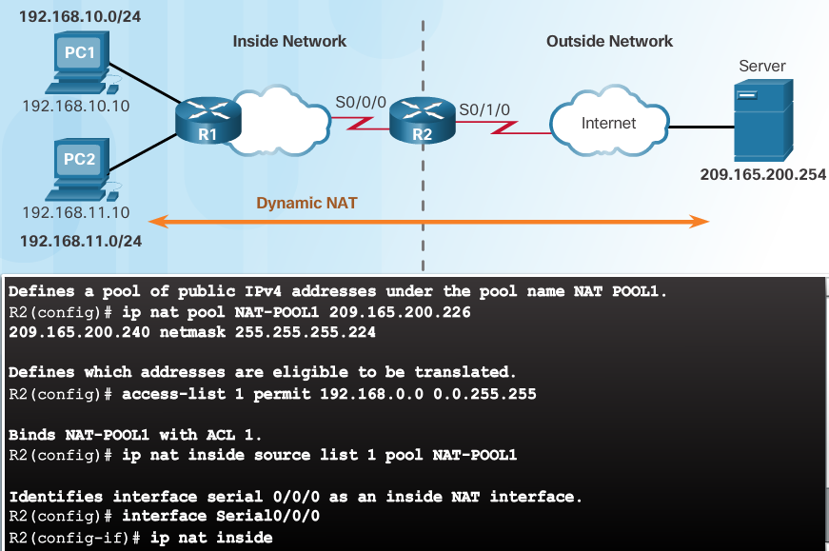
Configure Dynamic NAT Configuring Dynamic NAT (Cont.)
Notes:
9.2 – Configure NAT
9.2.2 – Configure Dynamic NAT
9.2.2.2 – Configuring Dynamic NAT (Cont.)

Slide 27
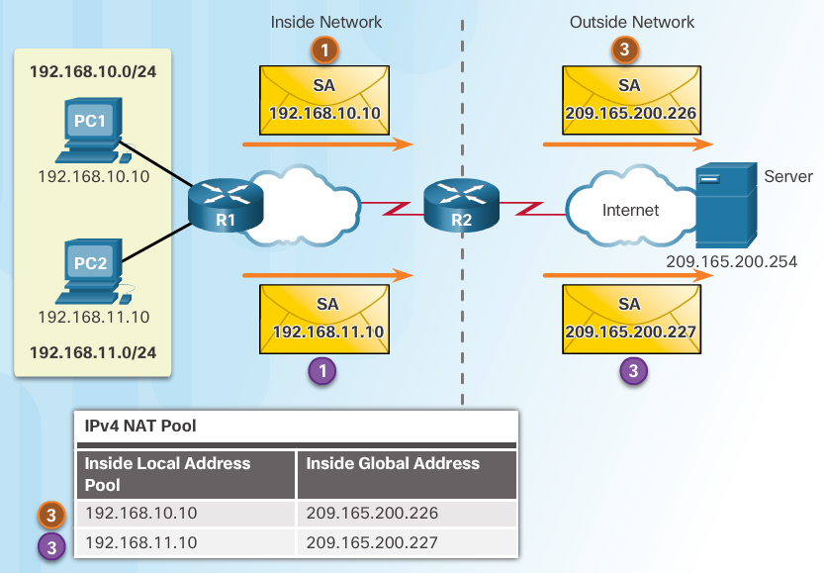
Configure Dynamic NAT Analyzing Dynamic NAT
PC1 and PC2 open a web browser for a connection to a web server.
R2 receives the packets on the inside interface and checks if translation should be performed (via an ACL). R2 assigns a global address from the NAT pool and creates a NAT table entry for both packets.
R2 replaces the inside local source address on each packet with the translated inside global address from the pool.
Notes:
9.2 – Configure NAT
9.2.2 – Configure Dynamic NAT
9.2.2.3 – Analyzing Dynamic NAT

Slide 28
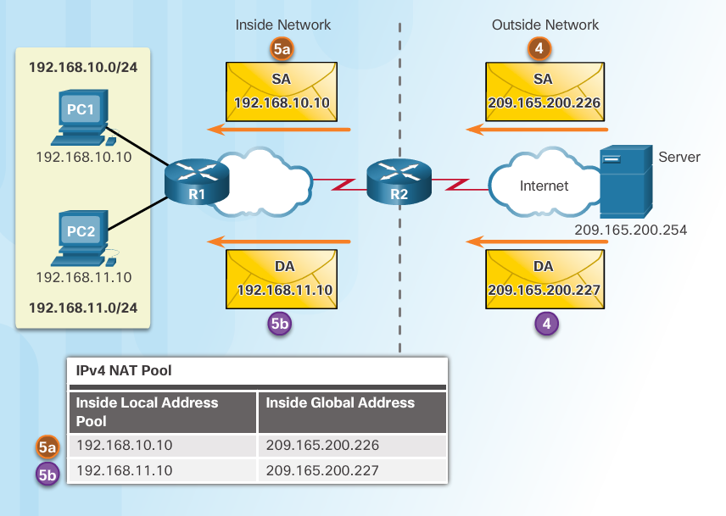
Configure Dynamic NAT Analyzing Dynamic NAT (Cont.)
The server responds to PC1 using the destination address of 209.165.200.226 (the NAT-assigned address) and to PC2 using the destination address of 209.165.200.227.
(a and b) R2 looks up each received packet and forwards based on the private IP address found in the NAT table for each of the destination addresses.
Notes:
9.2 – Configure NAT
9.2.2 – Configure Dynamic NAT
9.2.2.3 – Analyzing Dynamic NAT (Cont.)

Slide 29
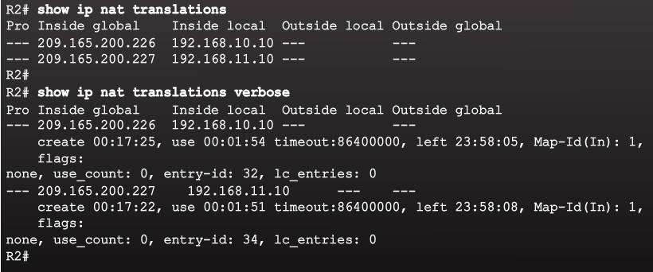
Configure Dynamic NAT Verifying Dynamic NAT
Notes:
9.2 – Configure NAT
9.2.2 – Configure Dynamic NAT
9.2.2.4 – Verifying Dynamic NAT

Slide 30
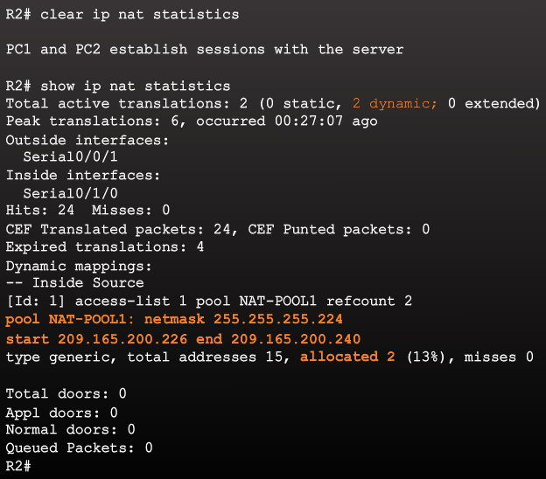
Configure Dynamic NAT Verifying Dynamic NAT (Cont.)
Notes:
9.2 – Configure NAT
9.2.2 – Configure Dynamic NAT
9.2.2.4 – Verifying Dynamic NAT (Cont.)

Slide 31
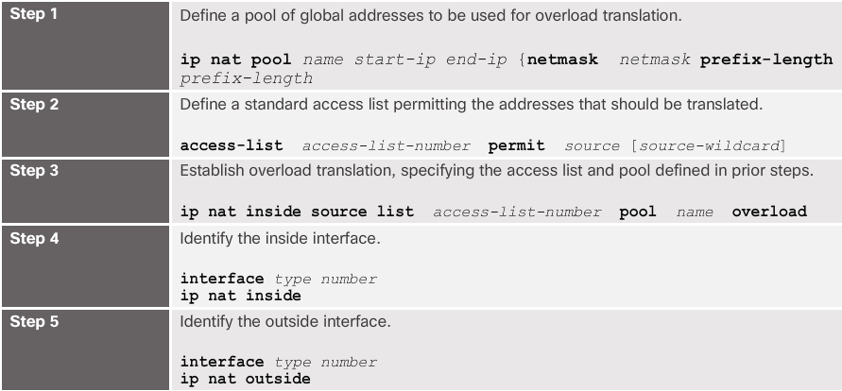
Configure PAT Configuring PAT: Address Pool
The pool contains the public addresses.
The ACL defines which private IP addresses gets translated.
The ip nat inside source list acl# pool name overload command ties Step 1 with Step 2.
The overload command is what allows the router to track port numbers (and do PAT instead of dynamic NAT).
Notes:
9.2 – Configure NAT
9.2.3 – Configure PAT
9.2.3.1 – Configuring PAT: Address Pool

Slide 32
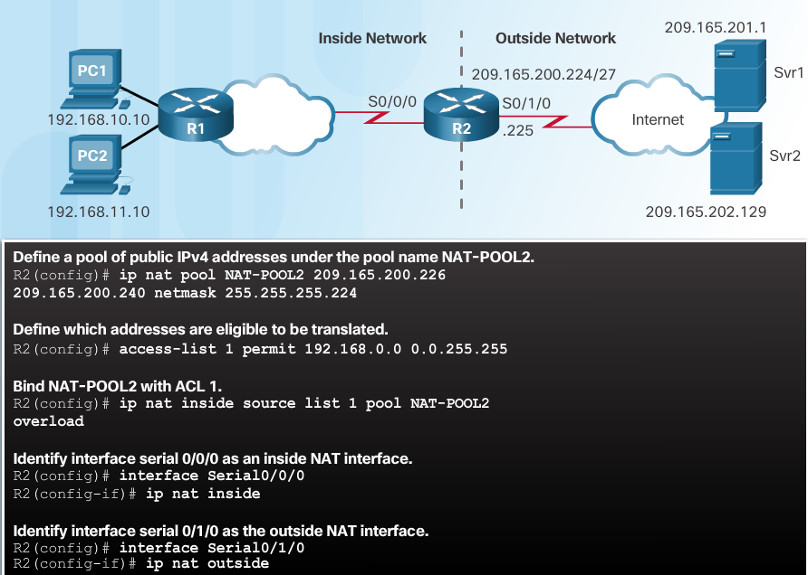
Configure PAT Configuring PAT: Address Pool (Cont.)
Notes:
9.2 – Configure NAT
9.2.3 – Configure PAT
9.2.3.1 – Configuring PAT: Address Pool (Cont.)

Slide 33
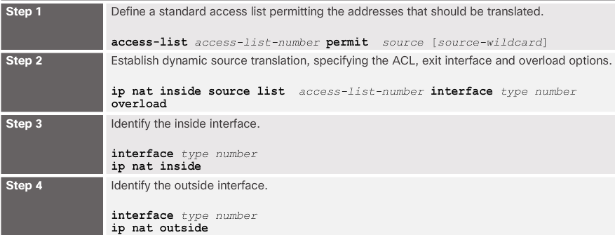
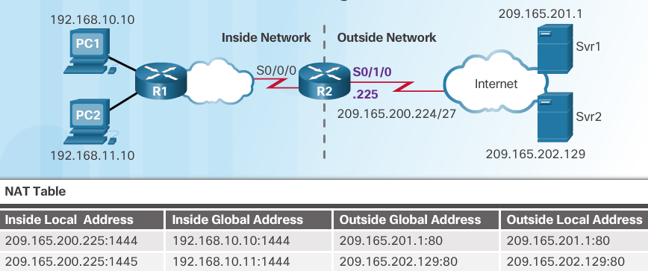
Configure PAT Configuring PAT: Single Address
When a public address is assigned to the external interface on the border router, that public address can be used for PAT and translate internal private IP addresses to the public IP address.
Still need an ACL to define which private IP addresses gets translated.
Instead of associating an ACL with a pool, the ACL is associated with an interface that has a public IP address assigned.
The overload command is always needed for PAT.
Notes:
9.2 – Configure NAT
9.2.3 – Configure PAT
9.2.3.2 – Configuring PAT: Single Address

Slide 34
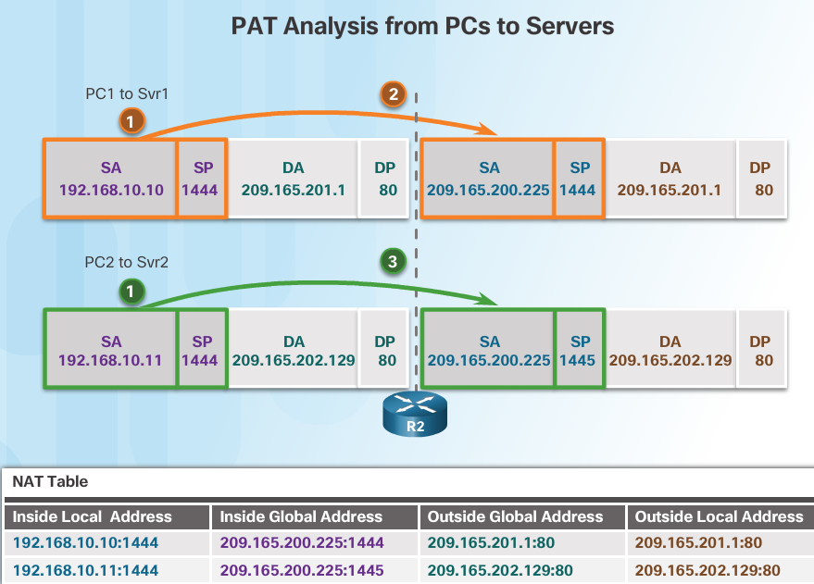
Configure PAT Analyzing PAT
PC1 and PC2 open a web browser for a connection to a web server.
R2 receives the packets on the inside interface and checks if translation should be performed (via an ACL). R2 assigns the IP address of the outside interface, adds a port number, and creates a NAT table entry for both packets.
R2 replaces the inside local source address on each packet with the translated inside global address.
Notes:
9.2 – Configure NAT
9.2.3 – Configure PAT
9.2.3.3 – Analyzing PAT

Slide 35
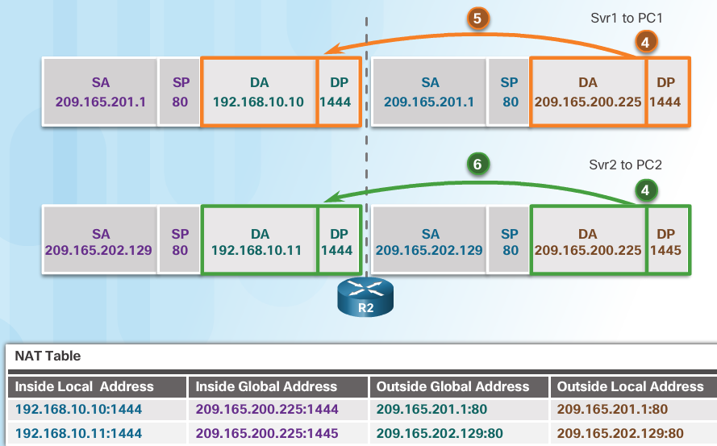
Configure PAT Analyzing PAT (Cont.)
Each server responds to PC1 and PC2 using the destination address of the public address assigned to the external interface on the border router.
R2 looks up the received packet and forwards to PC1 because that is the private IP address found in the NAT table for the destination address and port number.
R2 looks up the received packet and forwards to PC2 because that is the private IP address found in the NAT table for the destination address and port number.
Notes:
9.2 – Configure NAT
9.2.3 – Configure PAT
9.2.3.3 – Analyzing PAT (Cont.)

Slide 36
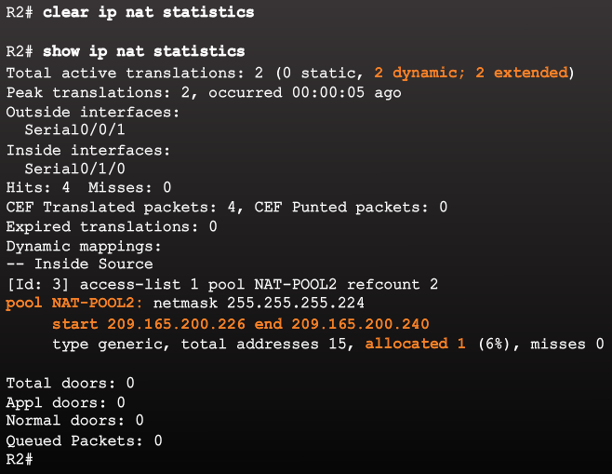
Configure PAT Verifying PAT
Notes:
9.2 – Configure NAT
9.2.3 – Configure PAT
9.2.3.4 – Verifying PAT

Slide 37
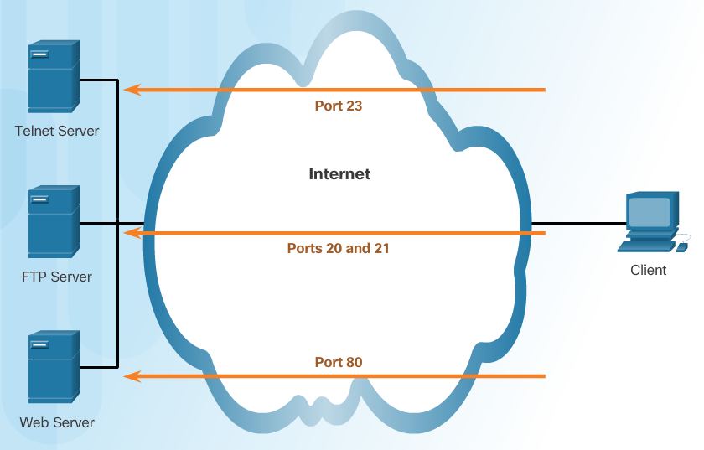
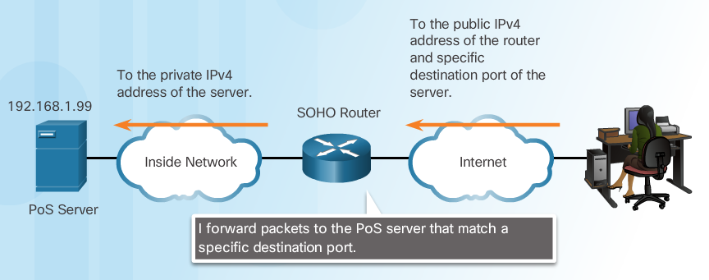
Configure Port Forwarding Port Forwarding
Port forwarding allows an external device to reach a device on a specific port number and the device is located on an internal (private) network.
Required for some peer-to-peer file-sharing programs and operations such as web serving and outgoing FTP
Solves the problem of NAT only allowing translations for traffic destined for external networks at the request of internal devices.
Notes:
9.2 – Configure NAT
9.2.4 – Configure Port Forwarding
9.2.4.1 – Port Forwarding

Slide 38
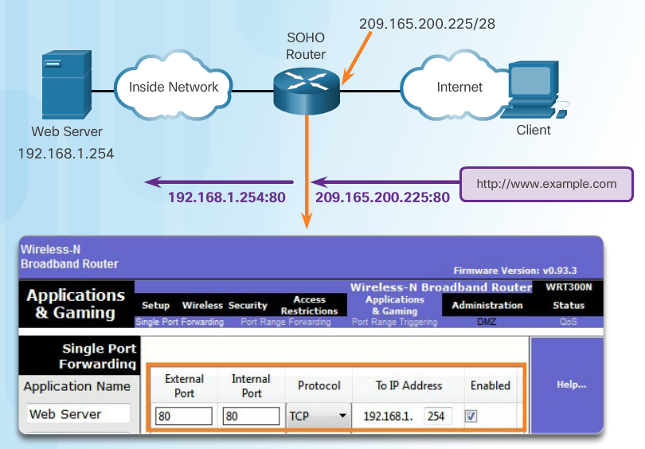
Configure Port Forwarding Wireless Router Example
Port forwarding can be enabled for specific applications
Must specify the inside local address that requests should be forwarded to
Notes:
9.2 – Configure NAT
9.2.4 – Configure Port Forwarding
9.2.4.2 – Wireless Router Example

Slide 39
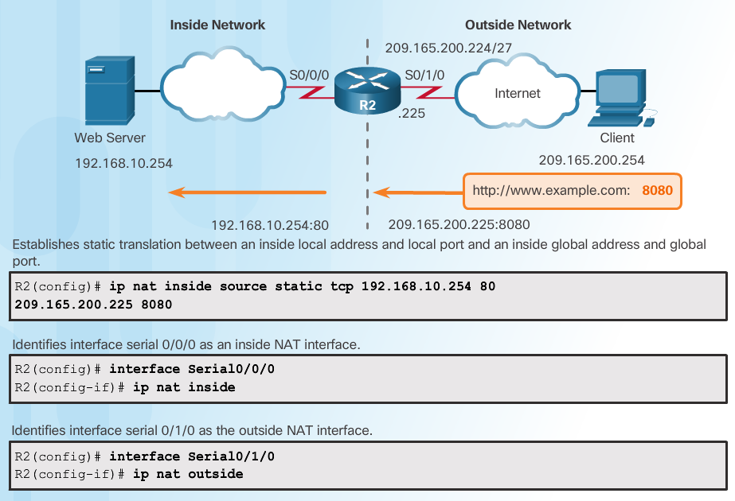
Configure Port Forwarding Configuring Port Forwarding with IOS
Notes:
9.2 – Configure NAT
9.2.4 – Configure Port Forwarding
9.2.4.3 – Configuring Port Forwarding with IOS

Slide 40
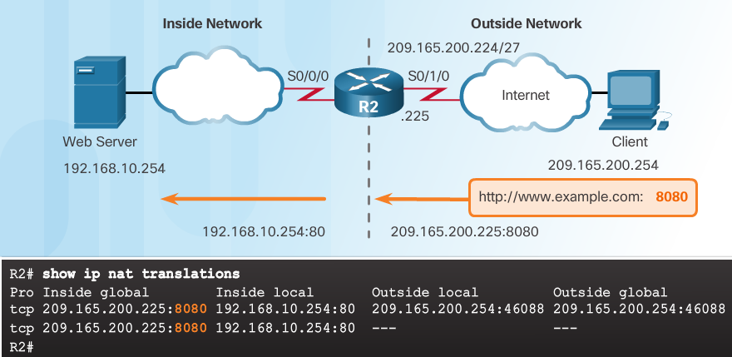
Configure Port Forwarding Configuring Port Forwarding with IOS (Cont.)
Notes:
9.2 – Configure NAT
9.2.4 – Configure Port Forwarding
9.2.4.3 – Configuring Port Forwarding with IOS (Cont.)

Slide 41
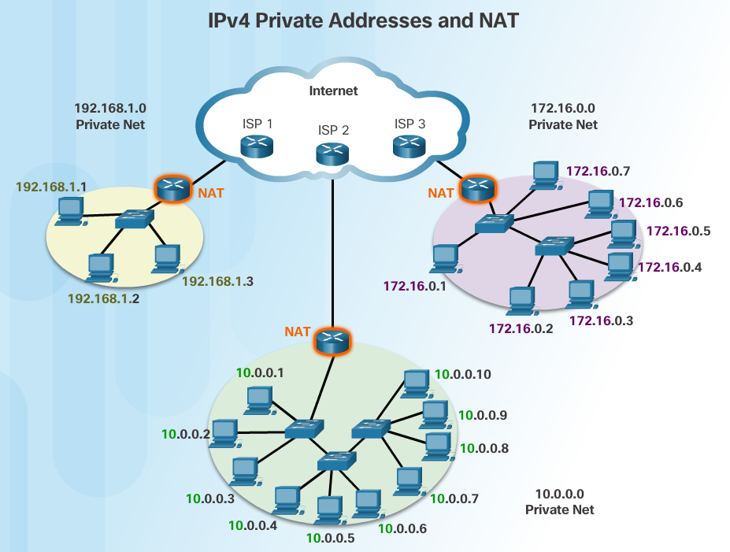
NAT and IPv6 NAT for IPv6?
IPv6 was developed with the intention of making NAT for IPv4 unnecessary
IPv6 does have its own form of NAT
IPv6 has its own private address space
Notes:
9.2 – Configure NAT
9.2.5 – NAT and IPv6
9.2.5.1 – NAT for IPv6?

Slide 42
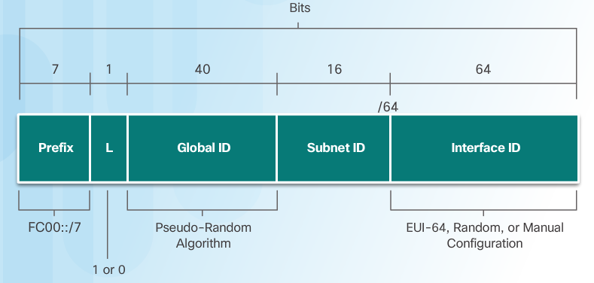
NAT and IPv6 IPv6 Unique Local Addresses
IPv6 unique local addresses (ULAs) are similar to IPv4 private addresses
ULAs are to provide IPv6 address space for communications within a local site.
First 64 bits of a ULA
Prefix of FC00::/7 (FC00 to FDFF)
Next bit is a 1 if the prefix is locally assigned
Next 40 bits define a global ID
Next 16 bits is a subnet ID
Last 64 bits of a ULA is the interface ID or host portion of the address
Allows sites to be combined without address conflicts
Allows internal connectivity
Not routable on the Internet
Notes:
9.2 – Configure NAT
9.2.5 – NAT and IPv6
9.2.5.2 – IPv6 Unique Local Addresses

Slide 43
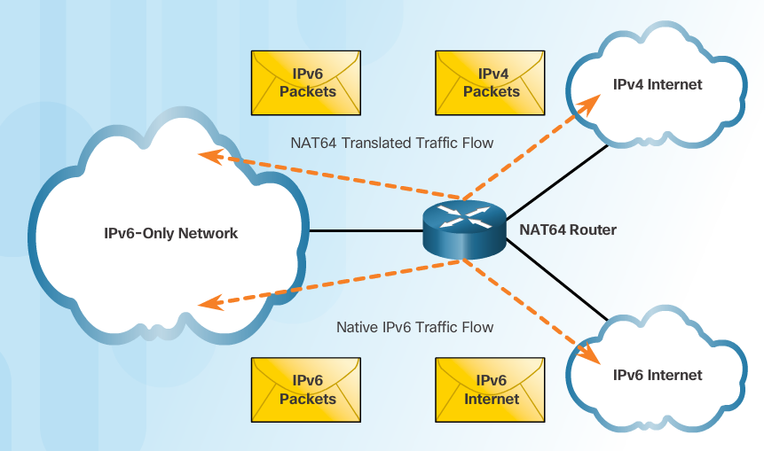
NAT and IPv6 NAT for IPv6
Provide access between IPv6-only and IPv4-only networks (not translating private address to public addresses as NAT for IPv4 was)
Techniques available
Dual-stack – both devices run protocols for both IPv4 and IPv6
Tunneling – Encapsulate the IPv6 packet inside an IPv4 packet for transmission over an IPv4-only network
NAT for IPv6 (translation)
Should not be used as a long term strategy
The older Network Address Translation-Protocol Translation (NAT-PT)
NAT64
Notes:
9.2 – Configure NAT
9.2.5 – NAT and IPv6
9.2.5.3 – NAT for IPv6

Slide 44
9.3 Troubleshoot NAT
Notes:
9 – NAT for IPv4
9.3 – Troubleshoot NAT

Slide 45
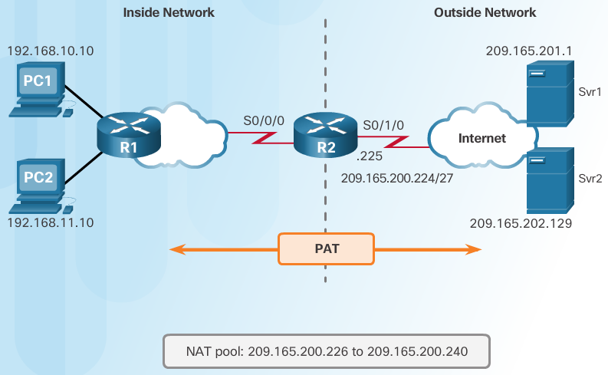
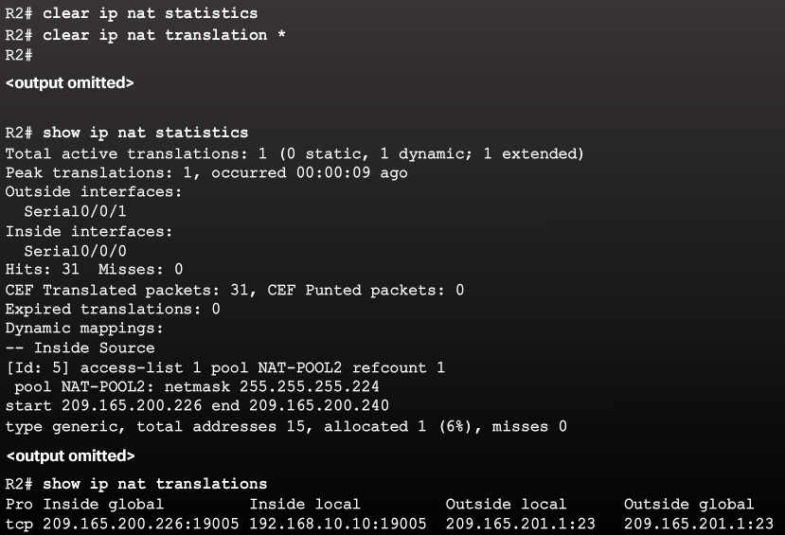
NAT Troubleshooting Commands The show ip nat Commands
Determine what NAT is supposed to achieve and compare with configuration. This may reveal a problem with the configuration.
Verify translations using the show ip nat translations command.
Use the clear and debug commands to verify NAT.
Review what is happening to the packet and verify routing.
Notes:
9.3 – Troubleshoot NAT
9.3.1 – NAT Troubleshooting Commands
9.3.1.1 – The show ip nat Commands

Slide 46
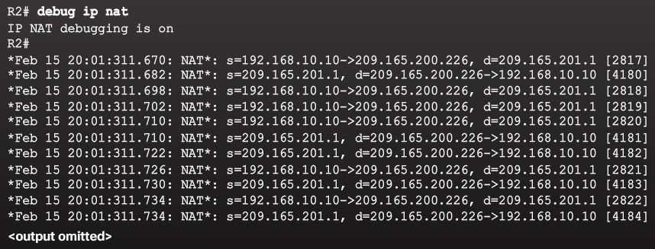
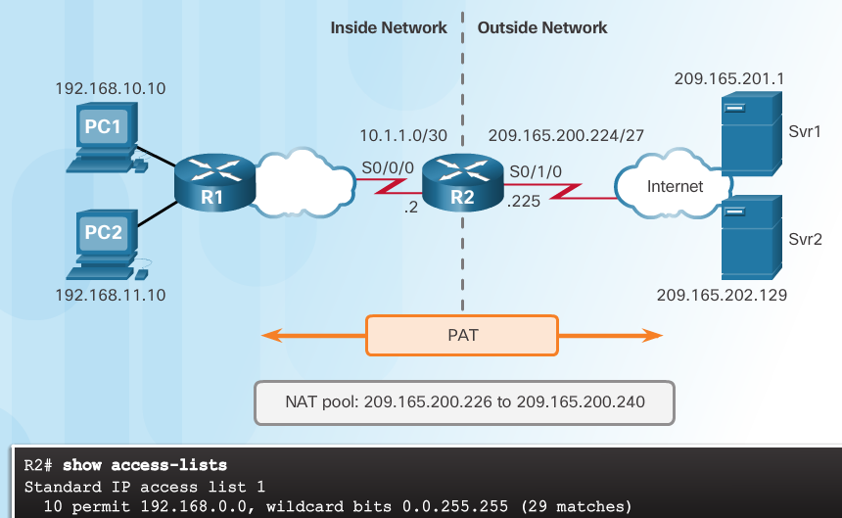
NAT Troubleshooting Commands The debug ip nat Commands
Common commands
debug ip nat
debug ip nat detailed
Output symbols and values
* - The translation is occurring in the fast-switched path
s= - Source IPv4 address
a.b.c.d--->w.x.y.z – Source a.b.c.d is translated to w.x.y.z.
d= - Destination IPv4 address
[xxxx] - IPv4 identification number
Check the ACL to ensure the correct private addresses are designated.
Notes:
9.3 – Troubleshoot NAT
9.3.1 – NAT Troubleshooting Commands
9.3.1.2 – The debug ip nat Commands

Slide 47
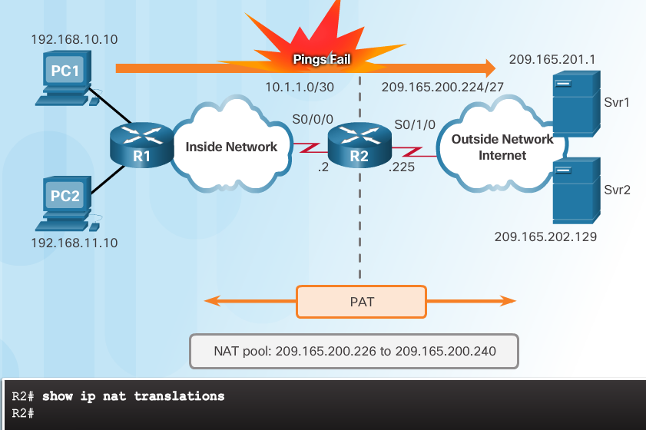
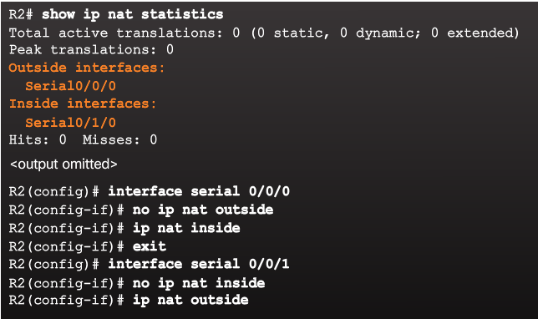
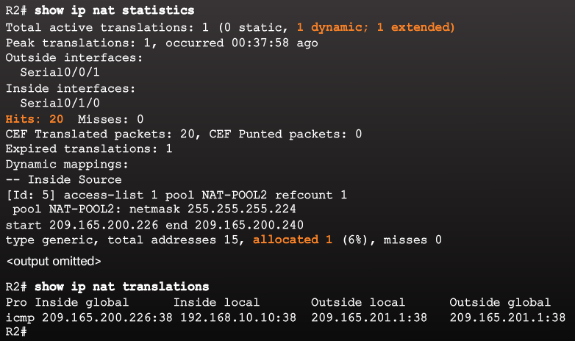
NAT Troubleshooting Commands NAT Troubleshooting Scenario
Internal hosts cannot contact external servers.
2. Outside and inside interfaces are reversed
1. No translations in NAT table
3. Incorrect ACL
Translations working!
Notes:
9.3 – Troubleshoot NAT
9.3.1 – NAT Troubleshooting Commands
9.3.1.3 – NAT Troubleshooting Scenario

Slide 48
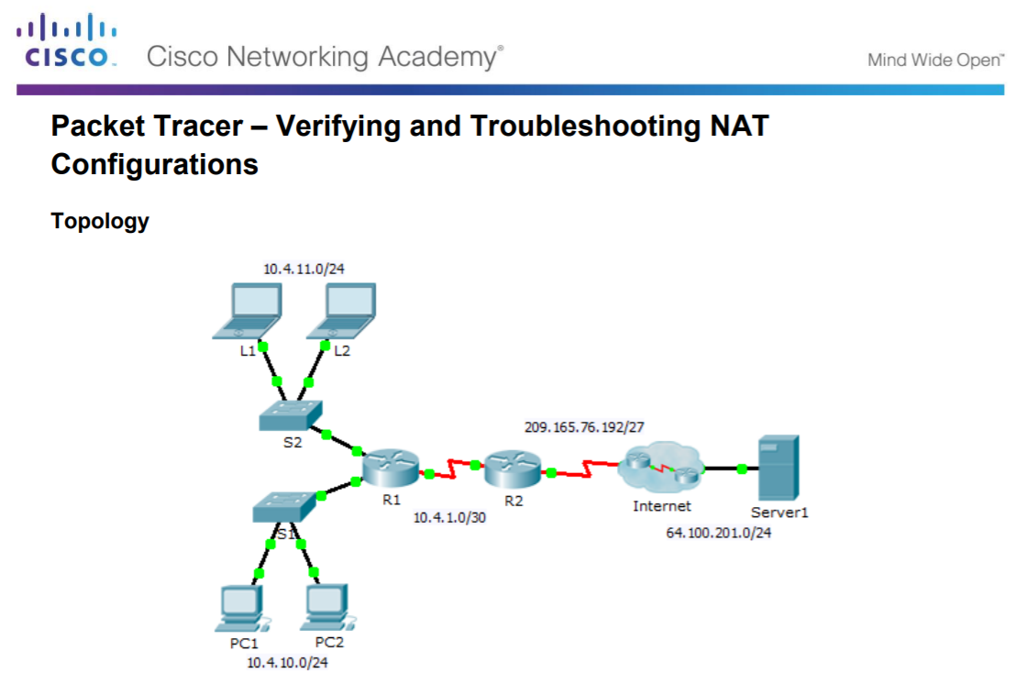
NAT Troubleshooting Commands Packet Tracer – Verifying and Troubleshooting NAT Configurations
Notes:
9.3 – Troubleshoot NAT
9.3.1 – NAT Troubleshooting Commands
9.3.1.4 – Packet Tracer – Verifying and Troubleshooting NAT Configurations

Slide 49
NAT Troubleshooting Commands Troubleshooting NAT Configurations
Notes:
9.3 – Troubleshoot NAT
9.3.1 – NAT Troubleshooting Commands
9.3.1.5 – Lab – Troubleshooting NAT Configurations

Slide 50
9.4 Chapter Summary
Notes:
9 – NAT for IPv4
9.4 – Summary

Slide 51
Conclusion Packet Tracer - Skills Integration Challenge
Notes:
9.4 – Summary
9.4.1 – Conclusion
9.4.1.2 – Packet Tracer - Skills Integration Challenge

Slide 52
Conclusion Chapter 9: NAT for IPv4
Explain how NAT provides IPv4 address scalability in a small to medium-sized business network.
Configure NAT services on the edge router to provide IPv4 address scalability in a small to medium-sized business network.
Troubleshoot NAT issues in a small to medium-sized business network.
Notes:
9.4 – Summary
9.4.1 – Conclusion
9.4.1.3 – NAT for IPv4

Slide 53
Module 9 New Terms and Commands
NAT RFC 1918 Inside local address Inside global address Outside local address Outside global address Static NAT Dynamic NAT PAT Next available port number ip nat inside source static | ip nat inside ip nat outside show ip nat translations show ip nat statistics clear ip nat statistics NAT pool ip nat pool ip nat inside source list show ip nat translations timeout show ip nat translations verbose | Port forwarding NAT for IPv6 IPv6 ULAs Dual-stack Tunneling NAT-PT NAT64 clear ip nat translation * debug ip nat debug ip nat detailed
Notes:
Module 9 - New Terms and Commands

