Slide 1
Chapter 2: Point-to-Point Connections
CCNA Routing and Switching
Connecting Networks v6.0
Notes:
Cisco Networking Academy Program
Connecting Networks v6.0
Chapter 2: Point-to-Point Connections

Slide 2
Chapter 2 - Sections & Objectives
2.1 Serial Point-to-Point Overview
  Configure HDLC encapsulation.
  Explain the fundamentals of point-to-point serial communication across a WAN.
  Configure HDLC encapsulation on a point-to-point serial link.
2.2 PPP Operation
  Explain how PPP operates across a point-to-point serial link.
  Compare PPP and HDLC.
  Explain the PPP-layered architecture and the functions of LCP and NCP.
  Explain how PPP establishes a session.
Notes:
2
Cisco Networking Academy Program
Connecting Networks v6.0
Chapter 2: Point-to-Point Connections

Slide 3
Chapter 2 - Sections & Objectives (Cont.)
2.3 PPP Implementation
  Configure PPP encapsulation.
  Configure PPP encapsulation on a point-to-point serial link.
  Configure PPP authentication.
  2.4 Troubleshoot WAN Connectivity
  Troubleshoot PPP.
  Troubleshoot PPP using show and debug commands.
Notes:
3
Cisco Networking Academy Program
Connecting Networks v6.0
Chapter 2: Point-to-Point Connections

Slide 4
2.1 Serial Point-to-Point Overview
Notes:
2 - Point-to-Point Connections
2.1 – Serial Point-to-Point Overview

Slide 5
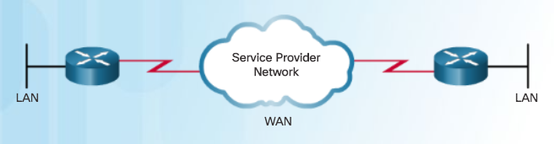
Serial Communications
Serial and Parallel Ports
A WAN is owned by a service provider and a LAN is typically owned by an organization.
Point-to-point connections connect LANs to service provider WANs and connect LAN segments.
A LAN-to-WAN point-to-point connection is also referred to as a serial connection or leased-line connection.
Lines are leased from a carrier.
Companies pay for a continuous connection between two remote sites, and the line is continuously active and available.
Serial Point-to-Point Connection
Notes:
2.1 – Serial Point-to-Point Overview
2.1.1 – Serial Communications
2.1.1.1 – Serial and Parallel Ports

Slide 6
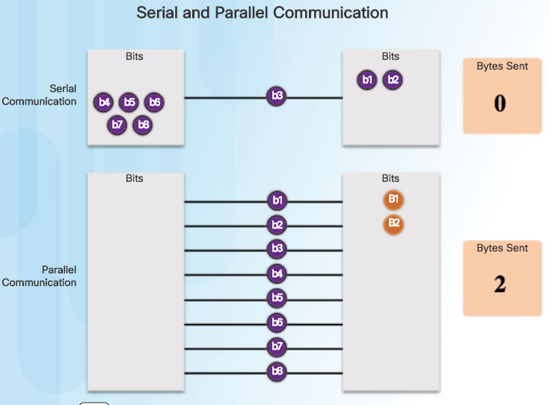
Serial Communications
Serial and Parallel Ports (Cont.)
Serial Communication
          Method of data transmissions in which the bits are transmitted sequentially over a single channel.
          Equivalent to a pipe only wide enough to fit one ball at a time. Multiple balls can go into the pipe, but only one at a time, and they only have one exit point, the other end of the pipe.
  Parallel communications
          Bits can be transmitted simultaneously over multiple wires.
          Sends a byte (eight bits) in the time that a serial connection sends a single bit.
          At one time, most PCs included both serial and parallel ports. Parallel ports were used to connect printers, computers, and other devices that required relatively high bandwidth.
    On most PCs, parallel ports and RS-232 serial ports have been replaced by the higher speed serial Universal Serial Bus (USB) interfaces.
Notes:
2.1 – Serial Point-to-Point Overview
2.1.1 – Serial Communications
2.1.1.1 – Serial and Parallel Ports

Slide 7
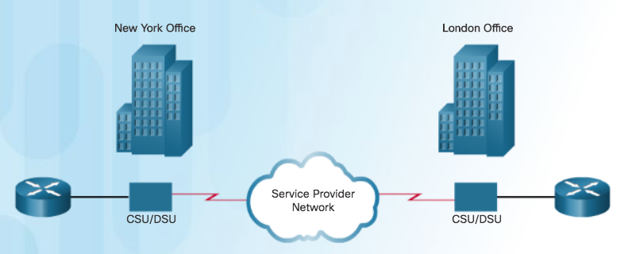
Serial Communications
Point-to-Point Communication Links
    Point-to-point link
      Used when permanent dedicated connections are required
      Provides a single, pre-established WAN communications path
      Path goes from the customer premises, through the provider network, to a remote destination, as shown in the figure
      Can connect two geographically distant sites, such as a corporate office in New York and a regional office in London
      Not limited to connections that cross land (undersea fiber-optics)
      Usually more expensive than shared services
      Constant availability is essential for some applications such as VoIP or video over IP.
Notes:
2.1 – Serial Point-to-Point Overview
2.1.1 – Serial Communications
2.1.1.2 – Point-to-Point Communication Links

Slide 8
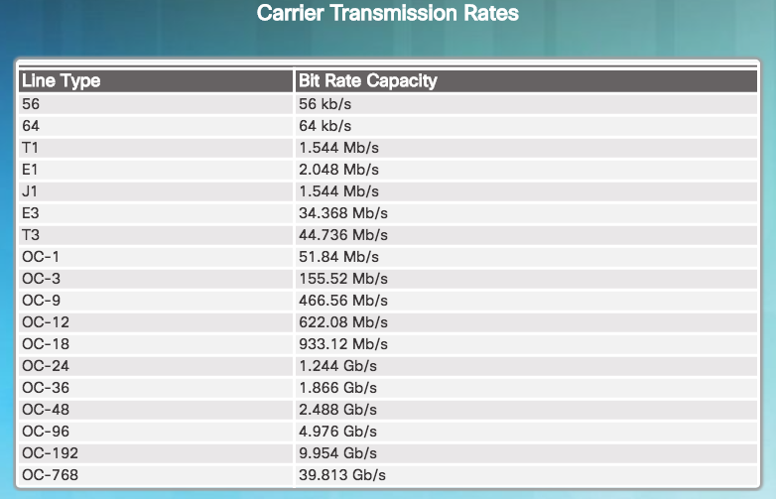
Serial Communications
Serial Bandwidth
    Bandwidth
      Refers to the rate at which data is transferred over the communication link.
      Carrier technology will dictate how much bandwidth is available.
        North American (T-carrier) specification
        European (E-carrier) system
        U.S. Optical Carrier (OC) bandwidth points
      OC transmission rates are a set of standardized specifications for the transmission of digital signals carried on SONET fiber-optic networks.
      In North America, expressed as a digital signal level number (DS0, DS1, etc.), which refers to the rate and format of the signal.
        Most fundamental line speed is 64 kb/s, or DS0.
        24 DS0s can be bundled to get a DS1 line (T1 line).
        28 DS1s can be bundled to get a DS3 line (T3 line).
Notes:
2.1 – Serial Point-to-Point Overview
2.1.1 – Serial Communications
2.1.1.3 – Serial Bandwidth

Slide 9
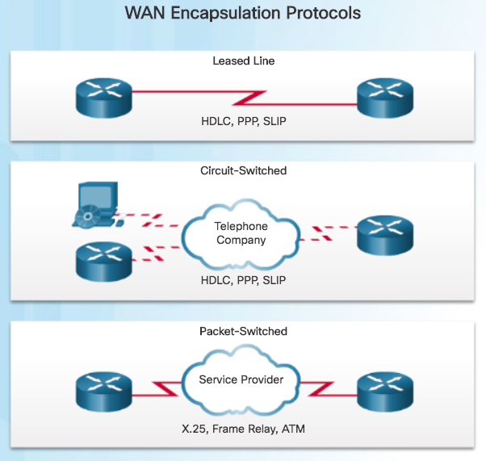
HDLC Encapsulation
WAN Encapsulation Protocols
    Data is encapsulated into frames before crossing the WAN link and must be configured for the appropriate Layer 2 protocol.
    Choice of protocol depends on the WAN technology and the communicating equipment.
    WAN protocols (HDLC and PPP are the focus of this course):
      HDLC - Default encapsulation on point-to-point connections, dedicated links, and circuit-switched connections when the link uses two Cisco devices.
      PPP - Provides router-to-router and host-to-network connections over synchronous and asynchronous circuits. Has built-in security mechanisms such as PAP and CHAP.
      Serial Line Internet Protocol (SLIP) - Displaced by PPP.
      X.25/Link Access Procedure, Balanced (LAPB) - Predecessor to Frame Relay.
      Frame Relay - Data link layer protocol that handles multiple virtual circuits. After X.25.
      ATM - International standard for cell relay in which devices send multiple service types, such as voice, video, or data, in fixed-length (53-byte) cells. Takes advantage of high-speed transmission media such as E3, SONET, and T3..
Notes:
2.1 – Serial Point-to-Point Overview
2.1.2 – HDLC Encapsulation
2.1.2.1 – WAN Encapsulation Protocols

Slide 10
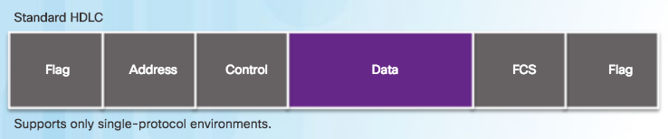
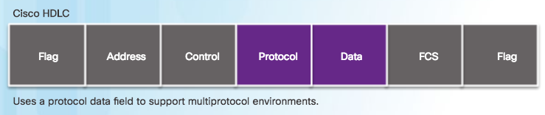
HDLC Encapsulation
HDLC Encapsulation
    HDLC is a synchronous data link layer protocol developed by the International Organization for Standardization (ISO).
    HDLC defines a Layer 2 framing structure that allows flow and error control through acknowledgments.
  Default serial encapsulation method when connecting two Cisco routers.
  Cisco’s HDLC is a point-to-point protocol that can be used on leased lines between two Cisco devices.
  Protocol field makes it possible for a single serial link to accommodate multiple network-layer protocols.
The figure compares standard HDLC to Cisco HDLC.
Uses a frame delimiter, or flag, to mark beginning and end of each frame.
  With an added protocol type field, Cisco HDLC can only work with other Cisco devices.
Notes:
2.1 – Serial Point-to-Point Overview
2.1.2 – HDLC Encapsulation
2.1.2.2 – HDLC Encapsulation

Slide 11
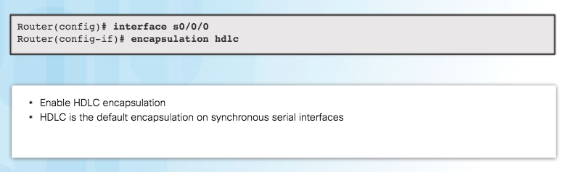
HDLC Encapsulation
Configuring HDLC Encapsulation
    Use Cisco HDLC as a point-to-point protocol on leased lines between two Cisco devices.
    If connecting non-Cisco devices, use synchronous PPP.
    If the default encapsulation method has been changed, use the encapsulation hdlc command in interface configuration mode to re-enable HDLC.
Notes:
2.1 – Serial Point-to-Point Overview
2.1.2 – HDLC Encapsulation
2.1.2.3 – Configuring HDLC Encapsulation

Slide 12
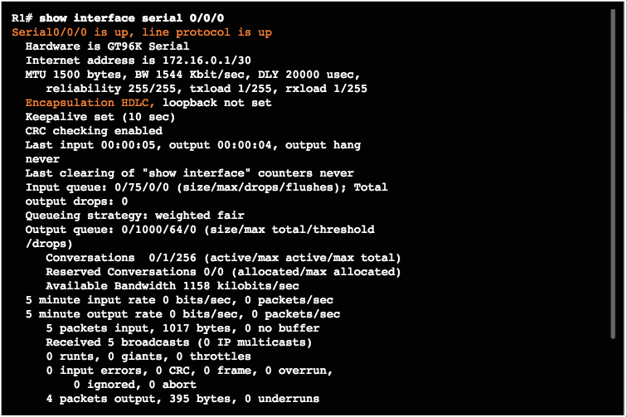
HDLC Encapsulation
Troubleshooting a Serial Interface
    The show interfaces serial x/x/x command displays information specific to serial interfaces.
    When HDLC is configured, “encapsulation HDLC” should be reflected in the output as highlighted in the figure.
    “Serial 0/0/0 is up, line protocol is up”, indicates that the line is up and functioning.
Notes:
2.1 – Serial Point-to-Point Overview
2.1.2 – HDLC Encapsulation
2.1.2.4 – Troubleshooting a Serial Interface

Slide 13
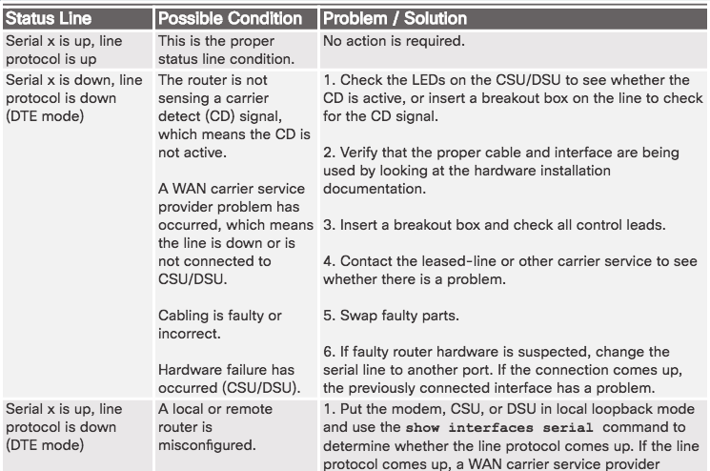
HDLC Encapsulation
Troubleshooting a Serial Interface (Cont.)
Serial interface issues associated with state, and how to troubleshoot the issue.
Notes:
2.1 – Serial Point-to-Point Overview
2.1.2 – HDLC Encapsulation
2.1.2.4 – Troubleshooting a Serial Interface

Slide 14
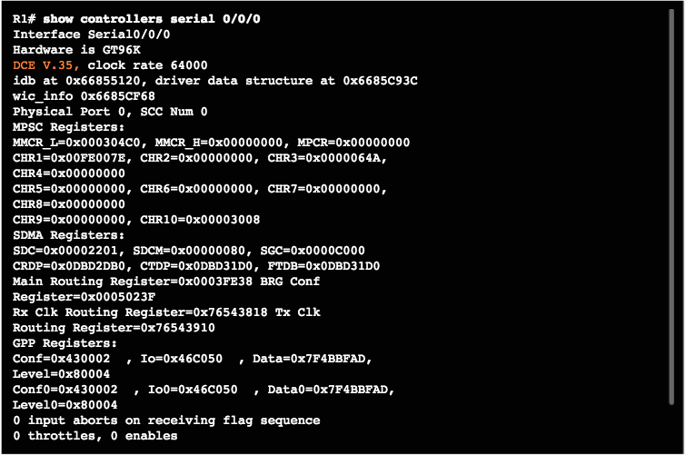
HDLC Encapsulation
Troubleshooting a Serial Interface (Cont.)
Show controllers command output indicates the state of the interface channels and whether a cable is attached to the interface. In the figure, interface serial 0/0/0 has a V.35 DCE cable attached.
Notes:
2.1 – Serial Point-to-Point Overview
2.1.2 – HDLC Encapsulation
2.1.2.4 – Troubleshooting a Serial Interface

Slide 15
2.2 PPP Operation
Notes:
2 - Point-to-Point Connections
2.2 – PPP Operation

Slide 16
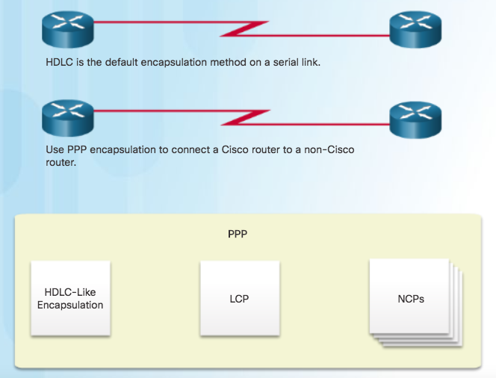
Benefits of PPP
Introducing PPP
PPP encapsulation should be used when there is a need to connect to a non-Cisco router.
PPP encapsulates data frames for transmission over Layer 2 physical links.
PPP establishes a direct connection using serial cables, phone lines, trunk lines, cellular telephones, specialized radio links, or fiber-optic links.
PPP contains three main components:
  HDLC-like framing for transporting multiprotocol packets over point-to-point links.
  Extensible Link Control Protocol (LCP) for establishing, configuring, and testing the data-link connection.
  Network Control Protocols (NCPs) for establishing and configuring different network layer protocols (IPv4 and IPv6 Control Protocol).
What is PPP?
Notes:
2.2 – PPP Operation
2.2.1 – Benefits of PPP
2.2.1.1 – Introducing PPP

Slide 17
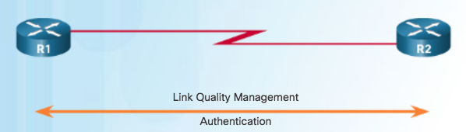
Benefits of PPP
Advantages of PPP
PPP includes many features not available in HDLC:
  The link quality management feature (LQM) monitors the quality of the link. LQM can be configured with the interface command ppp quality percentage. If the error percentage falls below the configured threshold, the link is taken down and packets are rerouted or dropped.
  PPP supports PAP and CHAP authentication.
Notes:
2.2 – PPP Operation
2.2.1 – Benefits of PPP
2.2.1.2 – Advantages of PPP

Slide 18
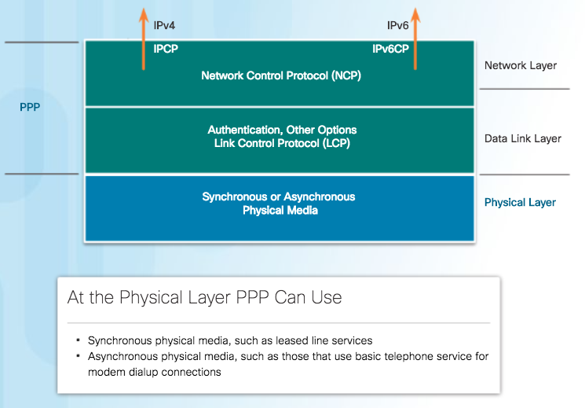
LCP and NCP
PPP Layered Architecture
The figure maps the layered architecture of PPP against the Open System Interconnection (OSI) model.
PPP and OSI share the same physical layer, but PPP distributes the functions of LCP and NCP differently.
PPP requires a full-duplex circuit, either dedicated or switched, that can operate in an asynchronous or synchronous bit-serial mode.
Most of the work done by PPP happens at the data link and network layers, by LCP and NCPs.
Notes:
2.2 – PPP Operation
2.2.2 – LCP and NCP
2.2.2.1 – PPP Layered Architecture

Slide 19
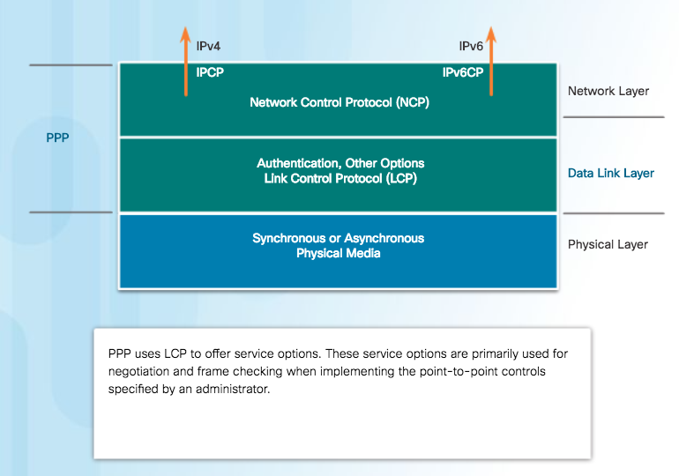
LCP and NCP
PPP – Link Control Protocol (LCP)
LCP functions within the data link layer and has a role in establishing, configuring, and testing the data-link connection.
LCP establishes the point-to-point link.
LCP also negotiates and sets up control options on the WAN data link, which are handled by the NCPs.
After the link is established, PPP also uses LCP to agree automatically on encapsulation formats such as authentication, compression, and error detection.
Notes:
2.2 – PPP Operation
2.2.2 – LCP and NCP
2.2.2.2 – PPP – Link Control Protocol (LCP)

Slide 20
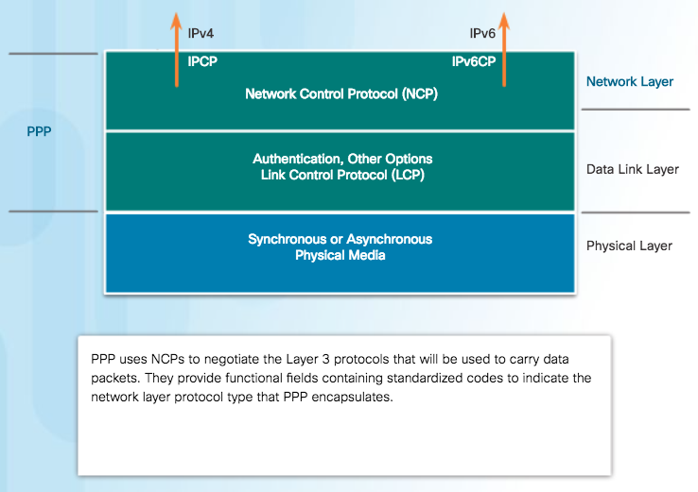
LCP and NCP
PPP – Network Control Protocol (NCP)
PPP permits multiple network layer protocols to operate on the same communications link.
For every network layer protocol used, PPP uses a separate NCP, as shown in the figure. IPv4 uses IP Control Protocol and IPv6 uses IPv6 Control Protocol.
NCPs include functional fields containing standardized codes to indicate the network layer protocol that PPP encapsulates.
  Value 8021 = IPCP
  Value 8057 = IPv6CP
Notes:
2.2 – PPP Operation
2.2.2 – LCP and NCP
2.2.2.3 – PPP – Network Control Protocol (NCP)

Slide 21
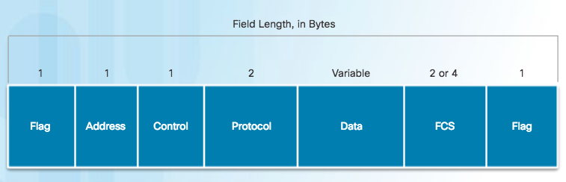
LCP and NCP
PPP Frame Structure
PPP Frame Fields
Flag - A single byte that indicates the beginning or end of a frame. The Flag field consists of the binary sequence 01111110.
Address - A single byte that contains the binary sequence 11111111, the standard broadcast address
Control - A single byte that contains the binary sequence 00000011, which calls for transmission of user data in an unsequenced frame.
Protocol - Two bytes that identify the protocol encapsulated in the information field of the frame.
Data - Zero or more bytes that contain the datagram for the protocol specified in the protocol field.
Frame Check Sequence (FCS) – This is normally 16 bits (2 bytes). If the receiver’s calculation of the FCS does not match the FCS in the PPP frame, the PPP frame is silently discarded
Notes:
2.2 – PPP Operation
2.2.2 – LCP and NCP
2.2.2.4 – PPP Frame Structure

Slide 22
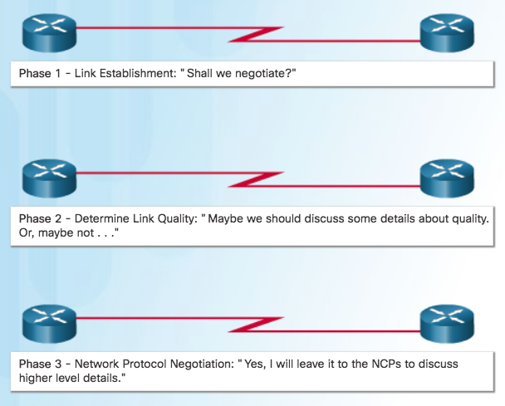
PPP Sessions
Establishing a PPP Session
Phase 1: Link establishment and configuration negotiation - Before PPP exchanges any network layer datagrams, such as IP, the LCP must first open the connection and negotiate configuration options. This phase is complete when the receiving router sends a configuration-acknowledgment frame back to the router initiating the connection.
Phase 2: Link quality determination (optional) - The LCP tests the link to determine whether the link quality is sufficient to bring up network layer protocols.
Phase 3: Network layer protocol configuration negotiation - After the LCP has finished Phase 2, the appropriate NCP can separately configure the network layer protocols, and bring them up and take them down at any time. If the LCP closes the link, it informs the network layer protocols so that they can take appropriate action.
Notes:
2.2 – PPP Operation
2.2.3 – PPP Sessions
2.2.3.1 – Establishing a PPP Session

Slide 23
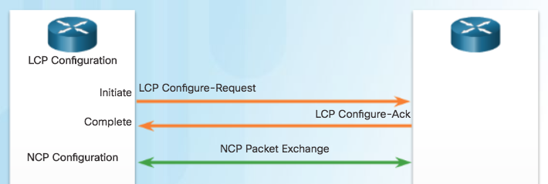
PPP Sessions
LCP Operation
Link Establishment
LCP operation includes provisions for 3 classes of LCP frames:
  Link-establishment frames
  Link-maintenance frames
  Link-termination frames
During link establishment, the LCP opens the connection and negotiates the configuration parameters. The link establishment process starts with the initiating device sending a Configure-Request frame to the responder.
Responder processes the request:
  If the options are not acceptable or not recognized, the responder sends a Configure-Nak or Configure-Reject message.
  If the options are acceptable, the responder responds with a Configure-Ack message and the process moves on to the authentication stage. The operation of the link is handed over to the NCP.
When NCP has completed all necessary configurations, including validating authentication, the line is available for data transfer. During the exchange of data, LCP transitions into link maintenance.
Notes:
2.2 – PPP Operation
2.2.3 – PPP Sessions
2.2.3.2 – LCP Operation

Slide 24
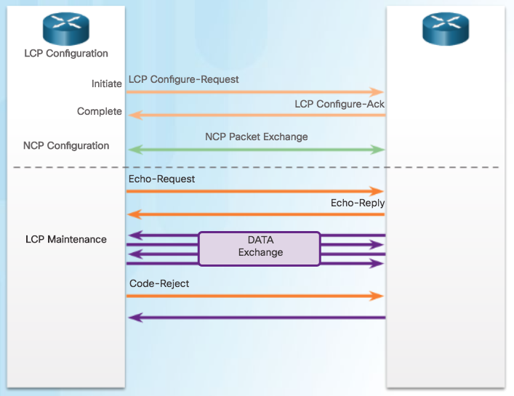
PPP Sessions
LCP Operation (Cont.)
During link maintenance, LCP can use messages to provide feedback and test the link.
  Echo-Request, Echo-Reply, and Discard-Request - These frames can be used for testing the link.
  Code-Reject and Protocol-Reject - These frame types provide feedback when one device receives an invalid frame. The sending device will resend the packet.
Link Maintenance
Notes:
2.2 – PPP Operation
2.2.3 – PPP Sessions
2.2.3.2 – LCP Operation

Slide 25
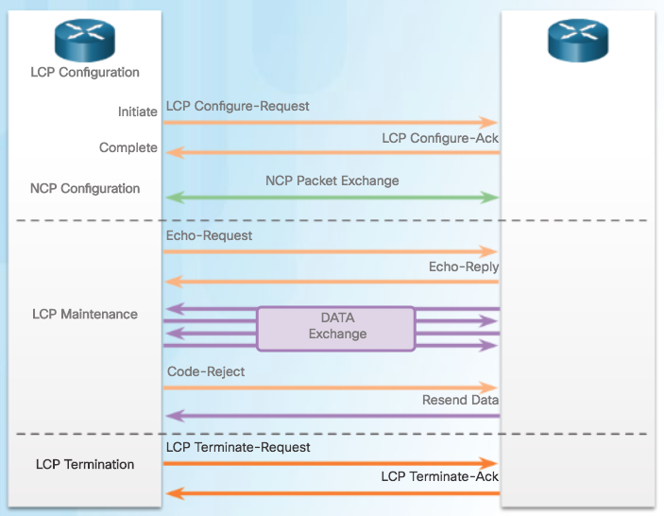
PPP Sessions
LCP Operation (Cont.)
Link Termination
  After the transfer of data at the network layer completes, the LCP terminates the link. NCP only terminates the network layer and NCP link. The link remains open until the LCP terminates it.
  PPP can terminate the link at any time because of the loss of the carrier, authentication failure, link quality failure, the expiration of an idle-period timer, or the administrative closing of the link.
  The LCP closes the link by exchanging Terminate packets.
  Device initiating the shutdown sends a Terminate-Request message. Other device replies with a Terminate-Ack.
Notes:
2.2 – PPP Operation
2.2.3 – PPP Sessions
2.2.3.2 – LCP Operation

Slide 26
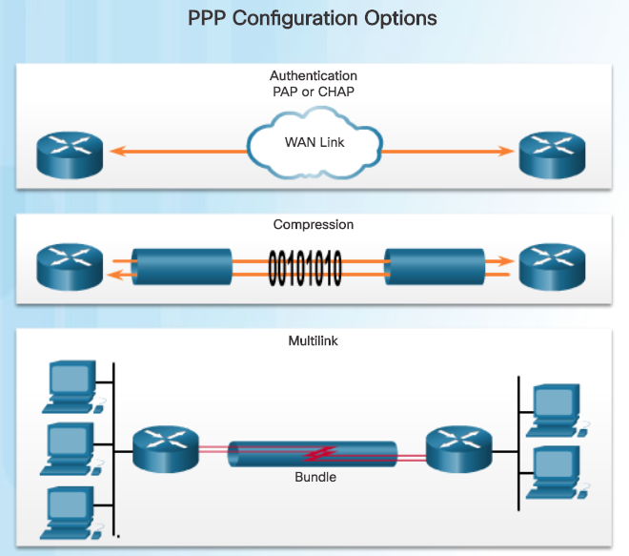
PPP Sessions
PPP Configuration Options
Authentication using either PAP or CHAP
Compression using either Stacker or Predictor
Multilink that combines two or more channels to increase the WAN bandwidth
Notes:
2.2 – PPP Operation
2.2.3 – PPP Sessions
2.2.3.3 – PPP Configuration Options

Slide 27
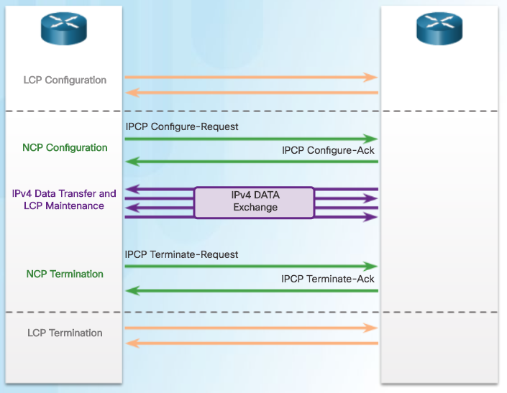
PPP Sessions
NCP Explained
After LCP has established the link, the routers exchange IPCP messages, negotiating options specific to IPv4.
IPCP is responsible for configuring, enabling, and disabling the IPv4 modules on both ends of the link.
IPCP negotiates two options:
  Compression - Allows devices to negotiate an algorithm to compress TCP and IP headers and save bandwidth.
  IPv4-Address - Allows the initiating device to specify an IPv4 address to use for routing IP over the PPP link, or to request an IPv4 address for the responder.
After the NCP process is complete, the link goes into the open state and LCP takes over again in a link maintenance phase.
When data transfer is complete, NCP terminates the protocol link and LCP terminates the PPP connection.
Notes:
2.2 – PPP Operation
2.2.3 – PPP Sessions
2.2.3.4 – NCP Explained

Slide 28
2.3 PPP Implementation
Notes:
2 - Point-to-Point Connections
2.3 – PPP Implementation

Slide 29
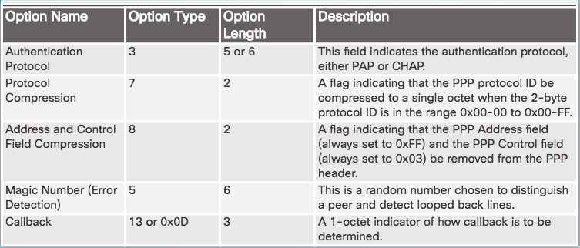
Configure PPP
PPP Configuration Options
Compression - Two compression protocols available in Cisco routers are Stacker and Predictor.
Error detection - Identifies fault conditions. The Quality and Magic Number options help ensure a reliable, loop-free data link.
PPP Callback - PPP callback is used to enhance security. With this LCP option, a Cisco router can act as a callback client or a callback server.
Configurable Options Field Codes
Notes:
2.3 – PPP Implementation
2.3.1 – Configure PPP
2.3.1.1 – PPP Configuration Options

Slide 30
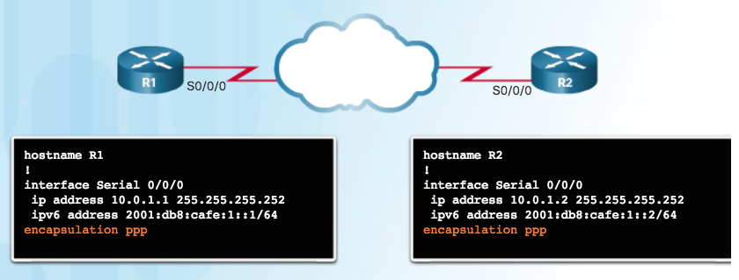
Configure PPP
PPP Basic Configuration Command
Remember that if PPP is not configured on a Cisco router, the default encapsulation for serial interfaces is HDLC.
PPP is a Layer 2 encapsulation that supports various Layer 3 protocols including IPv4 and IPv6.
Notes:
2.3 – PPP Implementation
2.3.1 – Configure PPP
2.3.1.2 – PPP Basic Configuration Command

Slide 31
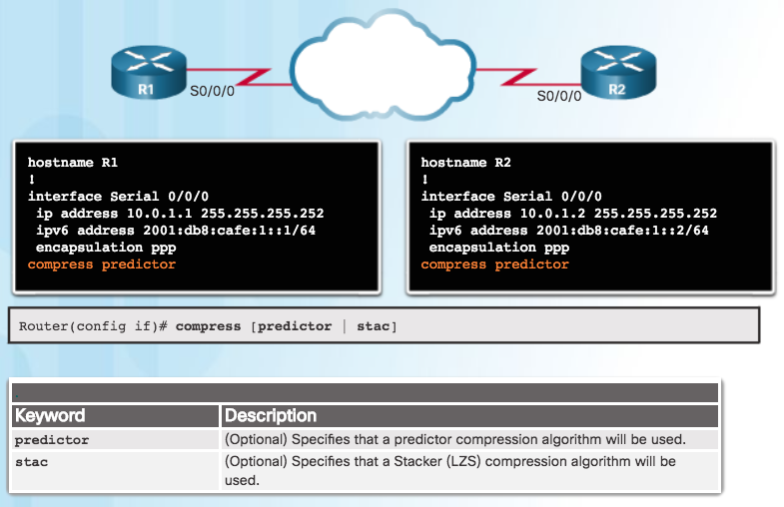
Configure PPP
PPP Compression Commands
Point-to-point software compression on serial interfaces can be configured after PPP encapsulation is enabled.
Because this option invokes a software compression process, it can affect system performance.
Notes:
2.3 – PPP Implementation
2.3.1 – Configure PPP
2.3.1.3 – PPP Compression Commands

Slide 32
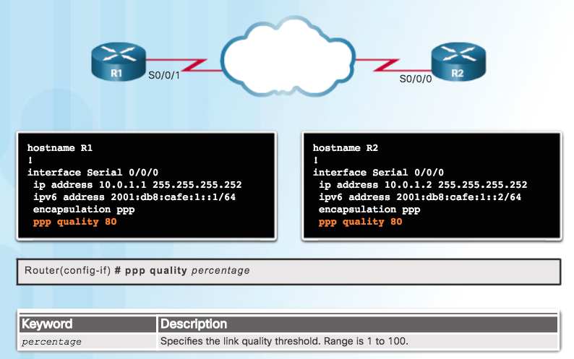
Configure PPP
PPP Link Quality Monitoring Command
The ppp quality percentage command ensures that the link meets the set quality requirement; otherwise, the link closes down
Percentages are calculated for both incoming and outgoing directions
Configuration ppp quality 80, shown in the figure, sets minimum quality to 80%
Notes:
2.3 – PPP Implementation
2.3.1 – Configure PPP
2.3.1.4 – PPP Link Quality Monitoring Command

Slide 33
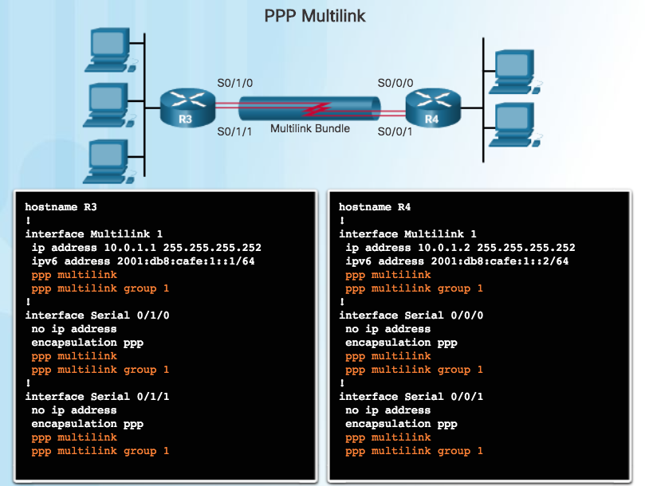
Configure PPP
PPP Multilink Commands
Multilink PPP provides a method for spreading traffic across multiple physical WAN links.
Configuring MPPP requires two steps, as shown in the figure.
  Step 1. Create a multilink bundle.
  Step 2. Assign interfaces to the multilink bundle.
To disable PPP multilink, use the no ppp multilink command on each of the bundled interfaces.
Notes:
2.3 – PPP Implementation
2.3.1 – Configure PPP
2.3.1.5 – PPP Multilink Commands

Slide 34
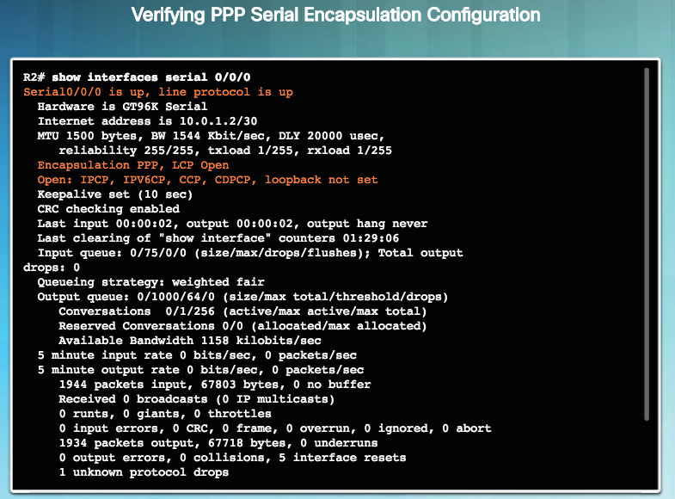
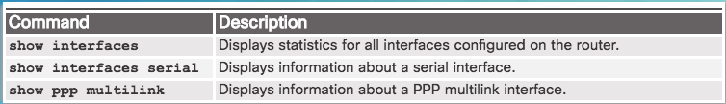
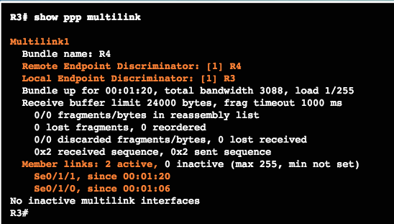
Configure PPP
Verifying PPP Configuration
Notes:
2.3 – PPP Implementation
2.3.1 – Configure PPP
2.3.1.6 – Verifying PPP Configuration

Slide 35
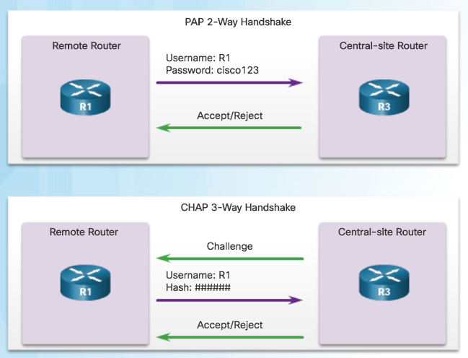
Configure PPP Authentication
PPP Authentication Protocols
PAP is a very basic two-way process with no encryption. The username and password are sent in plaintext. If it is accepted, the connection is allowed.
CHAP is more secure than PAP. It involves a three-way exchange of a shared secret.
The authentication phase of a PPP session is optional. If used, the peer is authenticated after LCP establishes the link and chooses the authentication protocol.
Authentication takes place before the network layer protocol configuration phase begins.
Notes:
2.3 – PPP Implementation
2.3.2 – Configure PPP Authentication
2.3.2.1 – PPP Authentication Protocols

Slide 36
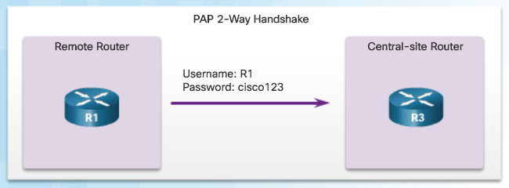
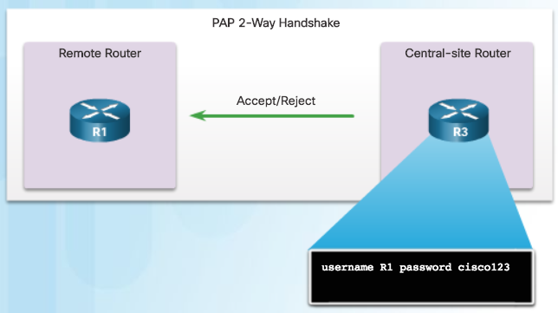
Configure PPP Authentication
Password Authentication Protocol (PAP)
Initiating PAP – R1 Sends its PAP username and password to R3.
Note: PAP is not a strong authentication protocol. Using PAP, passwords are sent across the link in plaintext and there is no protection from playback or repeated trial-and-error attacks.
Completing PAP – R3 Evaluates R1’s username and password against its local database. If it matches, it accepts the connection. If not, it rejects the connection.
Notes:
2.3 – PPP Implementation
2.3.2 – Configure PPP Authentication
2.3.2.2 – Password Authentication Protocol (PAP)

Slide 37

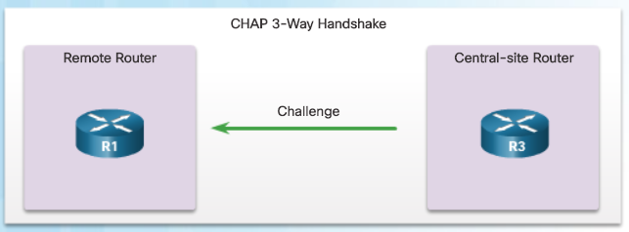
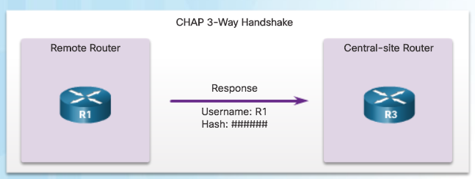
Configure PPP Authentication
Challenge Handshake Authentication Protocol (CHAP)
#1 R3 initiates the 3-way handshake and sends a challenge message to R1.
#3 The local router checks the response against its own calculation of the expected hash value. If the values match, the initiating node acknowledges the authentication.
#2 The remote node responds with a value that is calculated using a one-way hash function.
Note: CHAP conducts periodic challenges to make sure that the remote node still has a valid password value.
Notes:
2.3 – PPP Implementation
2.3.2 – Configure PPP Authentication
2.3.2.3 – Challenge Handshake Authentication Protocol (CHAP)

Slide 38
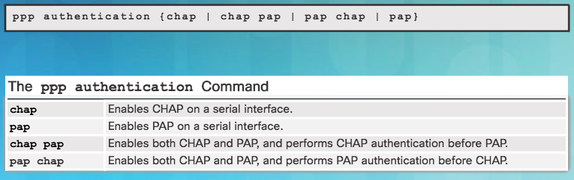
Configure PPP Authentication
PPP Authentication Command
To specify the order in which the CHAP or PAP protocols are requested on the interface, use the ppp authentication interface configuration command. Use the no form of the command to disable this authentication.
PAP, CHAP, or both can be enabled. If both methods are enabled, the first method specified is requested during link negotiation. If the peer suggests using the second method or simply refuses the first method, the second method should be tried.
Notes:
2.3 – PPP Implementation
2.3.2 – Configure PPP Authentication
2.3.2.4 – PPP Authentication Command

Slide 39
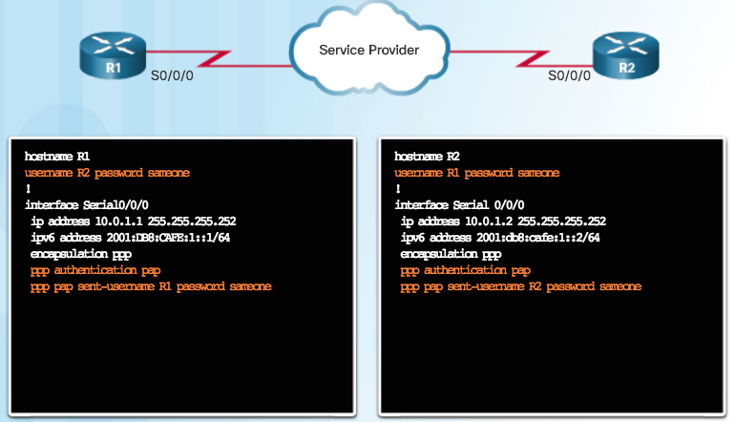
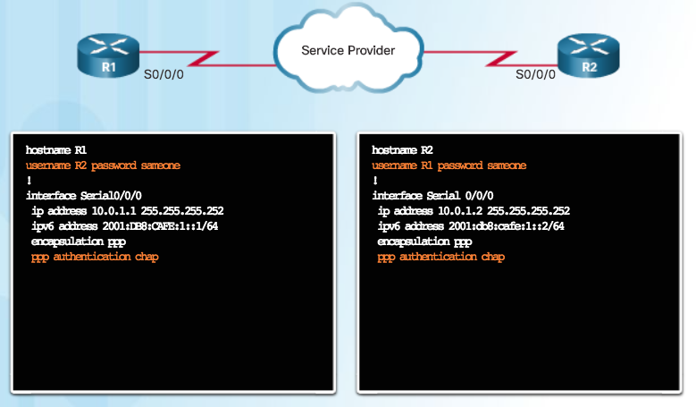
Configure PPP Authentication
Configuring PPP with Authentication
CHAP: Hostname on one router must match the username the other router has configured. The passwords must also match. Occurs on link establishment and can be repeated.
PAP Authentication Configuration
CHAP Authentication Configuration
PAP: Hostname on one router must match the username the other router has configured for PPP. The passwords must also match.
Notes:
2.3 – PPP Implementation
2.3.2 – Configure PPP Authentication
2.3.2.5 – Configuring PPP with Authentication

Slide 40
2.4 Troubleshoot WAN Connectivity
Notes:
2 - Point-to-Point Connections
2.4 – Troubleshoot WAN Connectivity

Slide 41
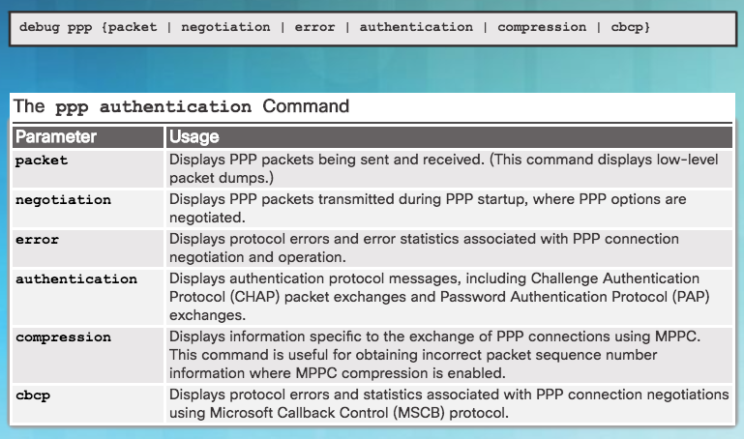
Troubleshoot PPP
Troubleshooting PPP Serial Encapsulation
debug ppp Command Parameters
debug command must not be used as a monitoring tool
meant to be used for a short period of time for troubleshooting
can consume a significant amount of resources
Notes:
2.4 – Troubleshoot WAN Connectivity
2.4.1 – Troubleshoot PPP
2.4.1.1 – Troubleshooting PPP Serial Encapsulation

Slide 42
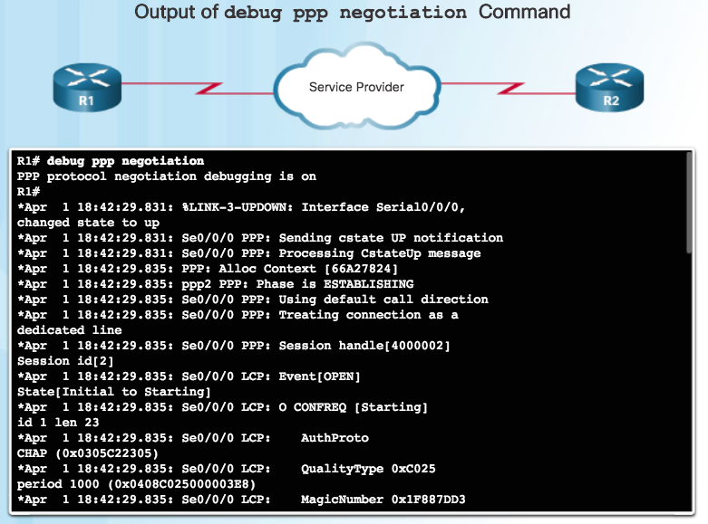
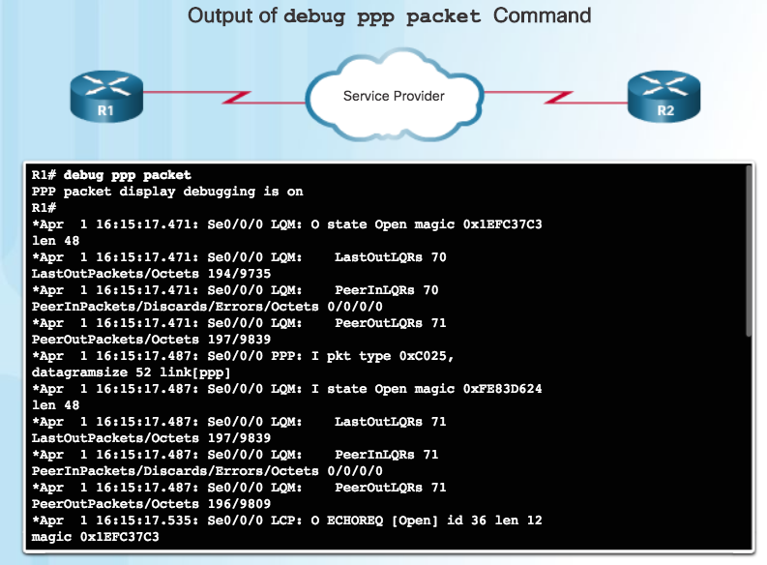
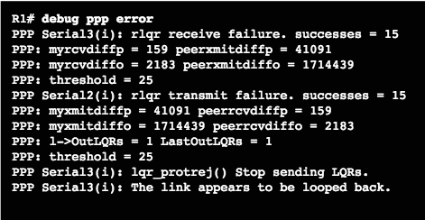
Troubleshoot PPP
Debug PPP
Notes:
2.4 – Troubleshoot WAN Connectivity
2.4.1 – Troubleshoot PPP
2.4.1.2 – Debug PPP

Slide 43
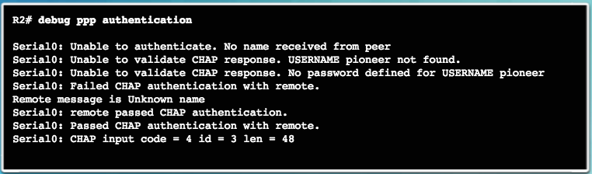
Troubleshoot PPP
Troubleshooting a PPP Configuration with Authentication
In the last line, the code 4 means that a failure has occurred. Other code values are as follows:
1 – Challenge 2 – Response 3 – Success 4 - Failure
id - 3 is the ID number per LCP packet format len - 48 is the packet length without the header
Notes:
2.4 – Troubleshoot WAN Connectivity
2.4.1 – Troubleshoot PPP
2.4.1.3 – Troubleshooting a PPP Configuration with Authentication

Slide 44
2.5 Summary
Notes:
2 – Point-to-Point Connections
2.5 – Summary

Slide 45
Conclusion
Chapter 2: Point-to-Point Connections
Configure HDLC encapsulation.
Explain how PPP operates across a point-to-point serial link.
Configure PPP encapsulation.
  Troubleshoot PPP
Notes:
2.5 – Summary
2.5.1 – Conclusion

Slide 46
Chapter 2
New Terms and Commands
High-Level Data Link Control (HDLC) Point-to-Point Protocol (PPP) serial connection parallel connection Clock skew parallel ports RS-232 serial ports Universal Serial Bus (USB) interfaces digital signal level (DS) synchronous circuits asynchronous circuits Password Authentication Protocol (PAP) Challenge Handshake Authentication Protocol (CHAP) Serial Line Internet Protocol (SLIP) | X.25 Link Access Procedure, Balanced (LAPB) bit-oriented Synchronous Data Link Control (SDLC) Carrier Detect (CD) signal Keepalives trunk lines Link Control Protocol (LCP) Network Control Protocols (NCPs) link quality management (LQM) IP Control Protocol (IPCP) IPv6 uses IPv6 Control Protocol (IPv6CP)
Notes:
New Terms and Commands

Slide 47
Chapter 2
New Terms and Commands (Cont.)
Link-establishment frames Link-maintenance frames Link-termination frames PPP Callback Multilink PPP Message Digest 5 (MD5)
Notes:
New Terms and Commands

